Slide 2
Aim
To learn about what sculpture is.
To learn about the materials used to create a sculpture.
To learn how to sculpt with modroc

Slide 3
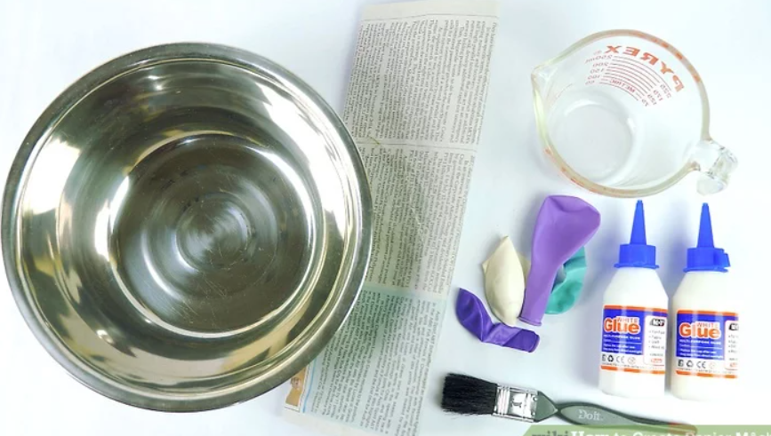
Paper mâché
Paper mâché (paper mash-ay) is an easy to make, hard material that can be used to cover various surfaces. It is often used in arts and crafts to make various sculptures, fruit bowls, puppets, dolls and much more. The surface is easy to paint, allowing you to add patterns, bright colors, and interesting designs to your finished product.
All you need is:
-A large container
-Flour or white glue
-Water
-A balloon (or a bowl)
-Paintbrush
-Newspaper or magazines
Video showing how to make the paste using flour and water.
Make sure an adult is here to help you though this stage
https://www.youtube.com/watch?v=OTKQGMy1Joo

Slide 4
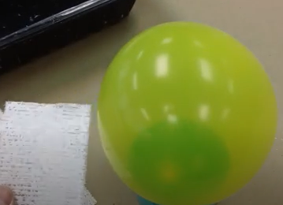
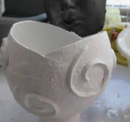
Mod Roc/Paper mâché
Repeat what you did last week to add a second layer of papier mache to your bowl to strengthen it.

Slide 5
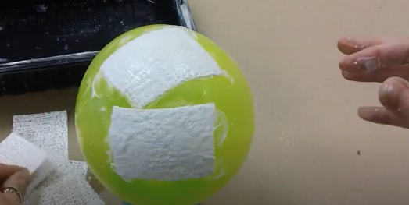
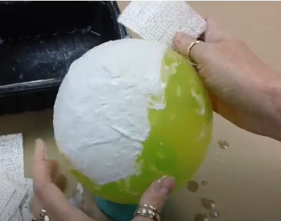
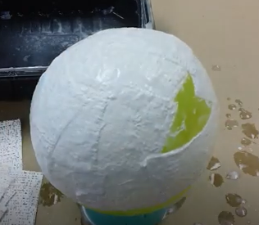
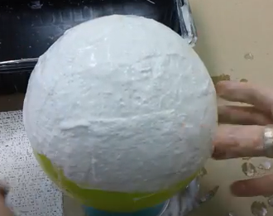
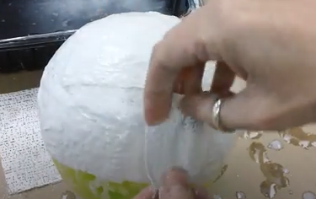
A Bowl made from Modroc/ Paper mâché

Slide 6
Mod Roc/ Paper mâché
Your bowl is going to need a stand.
Carefully coil the Modroc and build a stand so that your bowl stands upright.
Adding a stand to your bowl
Watch:
https://www.youtube.com/watch?app=desktop&v=-k0ybjbtoHc

Slide 7
Mod Roc/ Paper mâché
If you have time,
you may want to add
features to your
Bowl such as swirls
and patterns.

