Slide 1
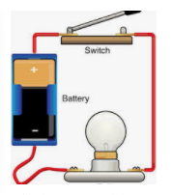
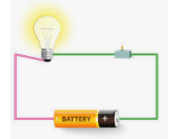
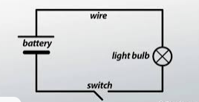
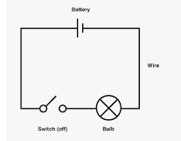
LO: To recognise that a switch opens and closes a circuit and associate this with whether or not a lamp lights in a simple series circuit

Slide 2
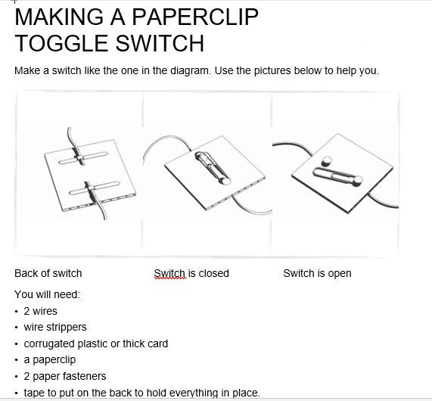
LO: To recognise that a switch opens and closes a circuit and associate this with whether or not a lamp lights in a simple series circuit

Slide 3
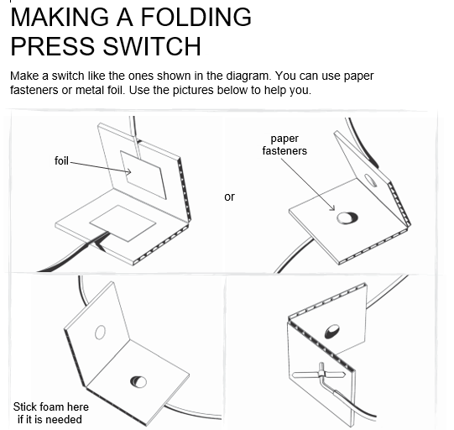
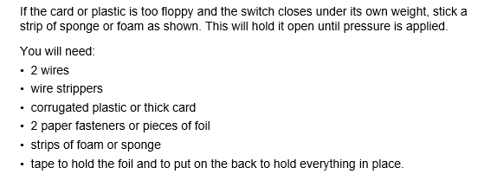
LO: To recognise that a switch opens and closes a circuit and associate this with whether or not a lamp lights in a simple series circuit

Slide 4
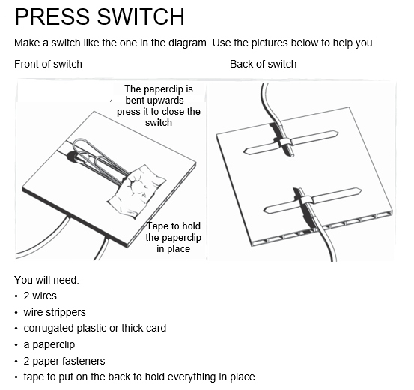
LO: To recognise that a switch opens and closes a circuit and associate this with whether or not a lamp lights in a simple series circuit

Slide 5
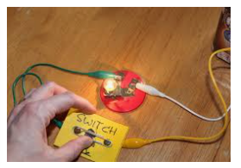
Key Questions
How does a switch work?
What is meant by a break in the circuit?
What different types of switches are there?
Why do we need to be able to make a break in a circuit?

