Slide 2
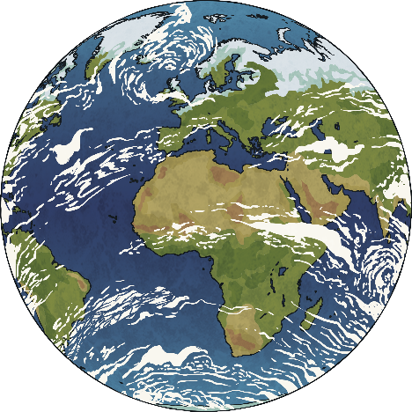
What Is the Difference between Weather and Climate?
Weather changes daily and it is the temperature and conditions for the day. Often we describe the weather as hot, rainy, sunny, humid, overcast, freezing or snowy.
Climate is the average weather condition of a place over a long period of time. The climate of a location is often linked to its location in the world. Places near the equator will have a hotter climate than places near the North and South Poles which will have a colder climate.

Slide 3
Types of Climate Zones
Biome
Description
Example
Polar
Very cold and dry all year round
Antarctica
Temperate
Cold winters and mild summers
UK
Arid
Dry and hot all year round
Sahara Desert
Tropical
Hot and wet all year round
Brazil
Mediterranean
Dry, hot summers and mild winters
Spain
Mountainous
Very cold, sometimes wet, all year
Himalayas
Let’s watch a video to see where we find these climates around the world.
Click here to start.

Slide 4
Click on the circles to reveal the location
UK
Temperate
Himalayas
Mountainous
Antarctica
Polar
North Africa
Arid
Brazil
Tropical
Spain
Mediterranean

Slide 5
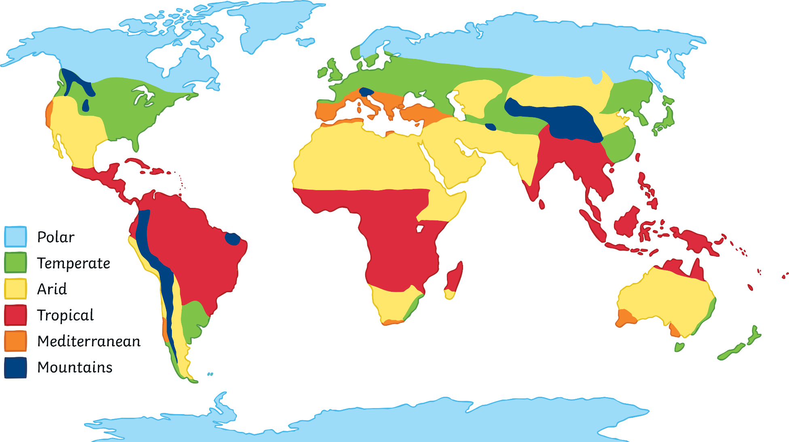
Climate Zone Locations
Grasslands

Slide 6
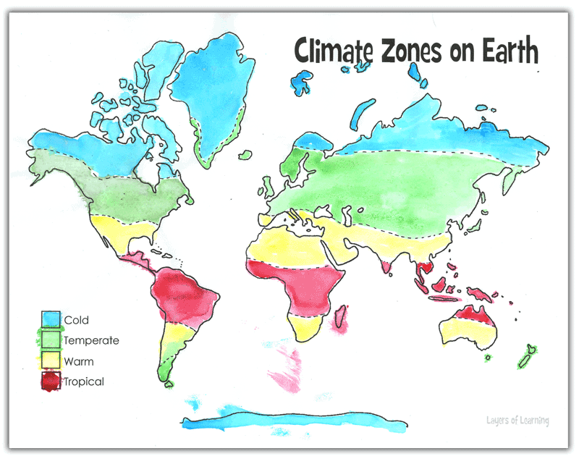
Example Y3:

Slide 7
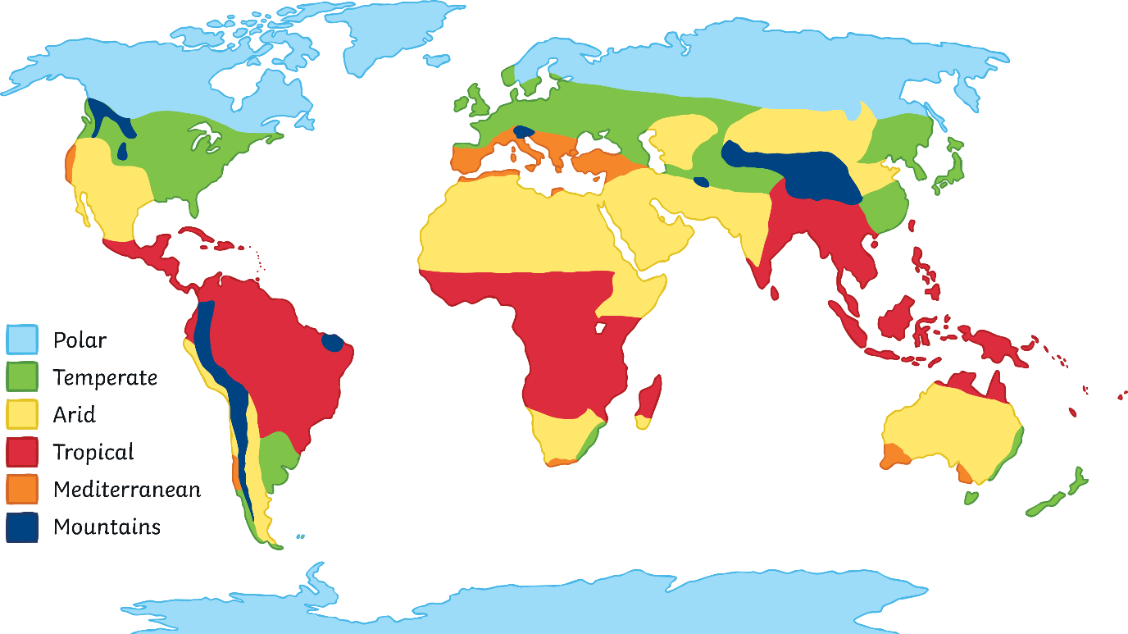
Use an atlas to help you answer these questions. What climate zone would each of these places have?
North Africa
India
Eastern USA
Russia
Central Australia
The UK

Slide 8


What is the climate in North Africa?
Arid

Slide 9
What is the climate in Northern Russia?
Polar

Slide 10
What is the climate in India?
Tropical

Slide 11
What is the climate in central Australia?
Arid

Slide 12
What is the climate in eastern USA?
Temperate

