Slide 1


Maths
Multiplication and Division
Year One
Maths | Year 4 | Multiplication and Division | Written Methods of Multiplication | Lesson 1 of 2: Expanded Multiplication with Two-Digit Numbers

Slide 2
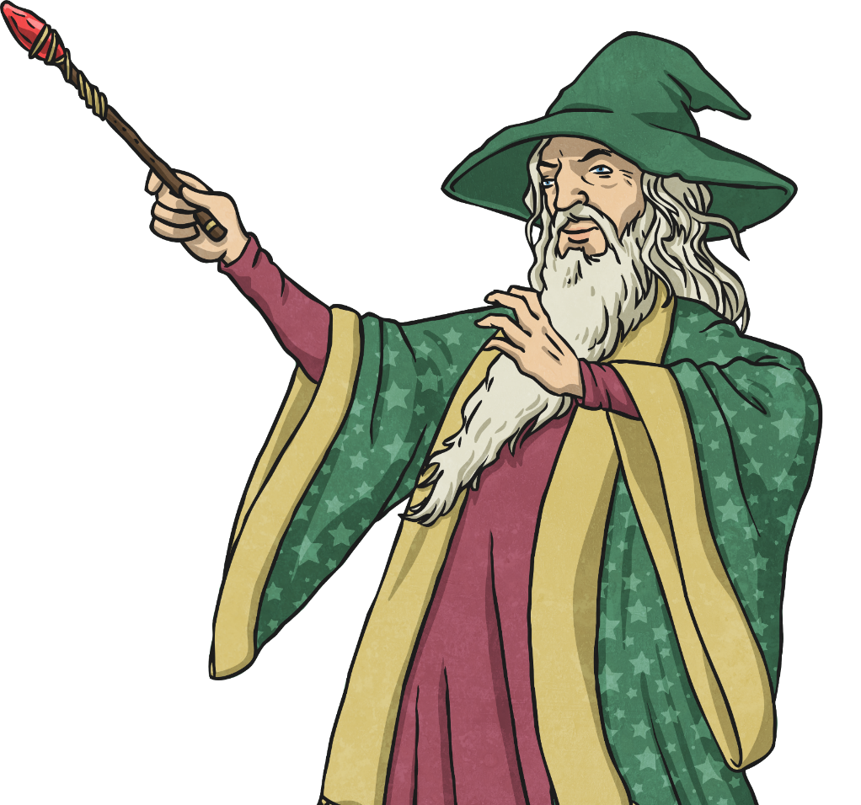

Expanded Multiplication with Two-Digit Numbers

Slide 3
Aim
I can multiply two-digit by one-digit numbers using expanded multiplication.
Success Criteria
I can set out the calculation correctly.
I can partition the calculation and multiply the ones then tens.
I can add the calculations together to find the answer.

Slide 4

The Grid Method
Do you remember how to solve multiplication problems using the grid method?

Slide 5

The Grid Method
Look at the problem.
22 × 4 = ?
Partition the large number into tens and ones.
22
20
2
Draw a grid.
× | 20 | 2
4

Slide 6

The Grid Method
Fill in the grid by solving 20 x 4, then 2 x 4.
× | 20 | 2
4 | 80 | 8
How did we work out 20 × 4?
Draw the wizard’s hat to find the multiplication facts.
Calculate the answer.
If we know 2 × 4 then we know the answer to 20 × 4.
How do we know this?

Slide 7
The Grid Method
After you have solved the calculations add the two answers together.
This gives you the answer to the problem.
× | 20 | 2
4 | 80 | 8
+
= 88
20 × 4 = 80
2 × 4 = 8
80 + 8 = 88
22 × 4 = 88

Slide 8
The Grid Method
Look at the problem.
Partition the large number.
Draw a grid.
Write the numbers into the grid.
Solve the calculations.
Add the answers together.
Write this number at the end of the problem to finish answering the question.
Example Answer
× | 20 | 2
4 | 80 | 8
+
22 x 4 = 88

Slide 9
Expanded Multiplication
We’re going to learn a new method of multiplication, called the expanded multiplication.
Expanded multiplication is like the grid method, but quicker to write down.
We are going to lay our multiplication problems out in columns instead of grids.

Slide 10
Expanded Multiplication
 | 3 | 6
x |  | 7
Lay out your calculation in a grid.
4
2
Work out 6 × 7 and write the answer here.
2
1
0
Work out 30 × 7 and write the answer here.
Add them together and write your answer here.
2
5
2

Slide 11

Expanded Multiplication
 | 4 | 8
x |  | 8
Lay out your calculation in a grid.
6
4
Work out 8 × 8 and write the answer here.
3
2
0
Work out 40 × 8 and write the answer here.
Add them together and write your answer here.
3
8
4

Slide 12
Expanded Multiplication
 | 6 | 8
x |  | 8
Lay out your calculation in a grid.
4
Work out 8 × 8 and write the answer here.
6
4
8
Work out 60 × 8 and write the answer here.
0
5
1
4
Add them together and write your answer here.
4
If there are more than 9 tens, regroup them as hundreds and write them under the hundreds column, remembering to add them onto the total.

Slide 13
Expanded Multiplication
 | 8 | 4
x |  | 6
Lay out your calculation in a grid.
4
Work out 4 × 6 and write the answer here.
2
4
8
Work out 80 × 6 and write the answer here.
0
5
1
0
Add them together and write your answer here.
4
If there are more than 9 tens, regroup them as hundreds and write them under the hundreds column, remembering to add them onto the total.

Slide 14


Medal Multiplication
Bronze | Silver | Gold
20 × 3 = 32 × 5 = 16 × 4 = | 42 × 6 = 51 × 9 = 64 × 7 = | 58 × 8 = 95 × 9 = 69 × 7 =
60
252
464
160
459
855
64
448
483

