Slide 1
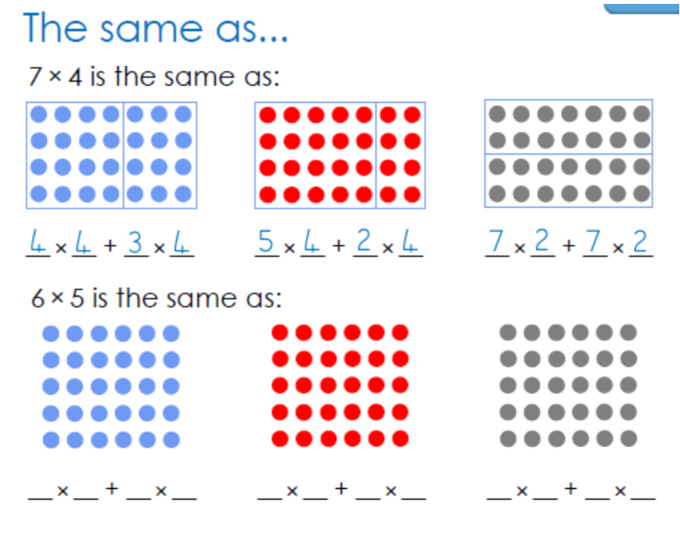
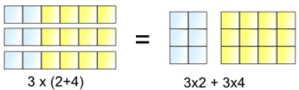
The distributive law
The Distributive Law says that multiplying a number by a group of numbers added together is the same as doing each multiplication separately.
Using this law, can you complete the second calculation?

Slide 2
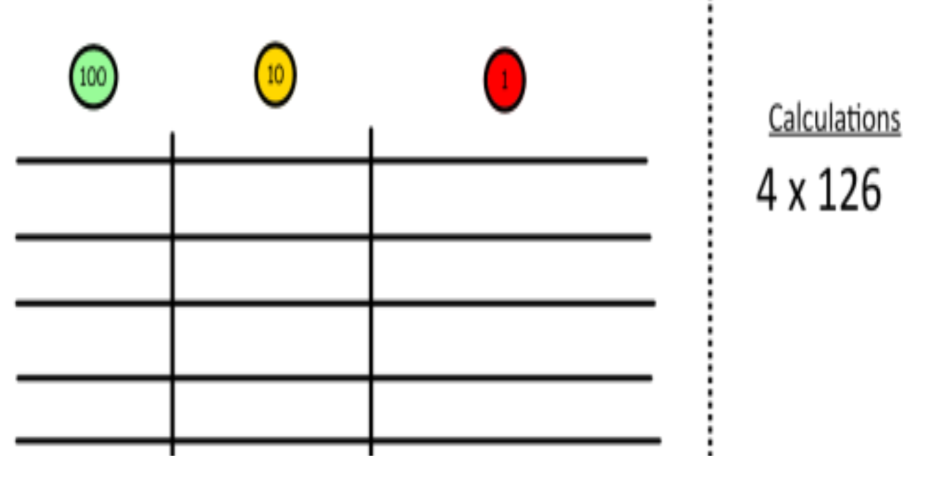



How can we use this law with larger numbers?
(100 + 20 + 6 )
4 x 126 =
4x100
+ 4 x 20
+ 4 x 6

Slide 3




How can we use this law with larger numbers?
(200 + 10 + 5 )
3 x 215 =
3 x 200
+ 3 x 10
+ 3 x 5

Slide 4
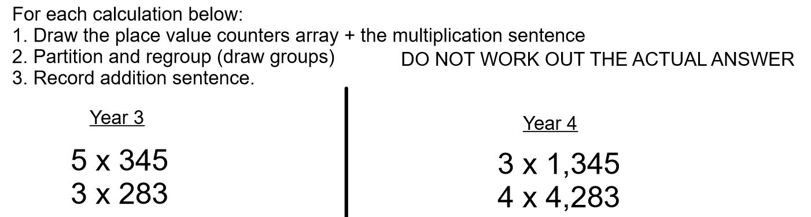
Now it’s your turn:

Slide 5
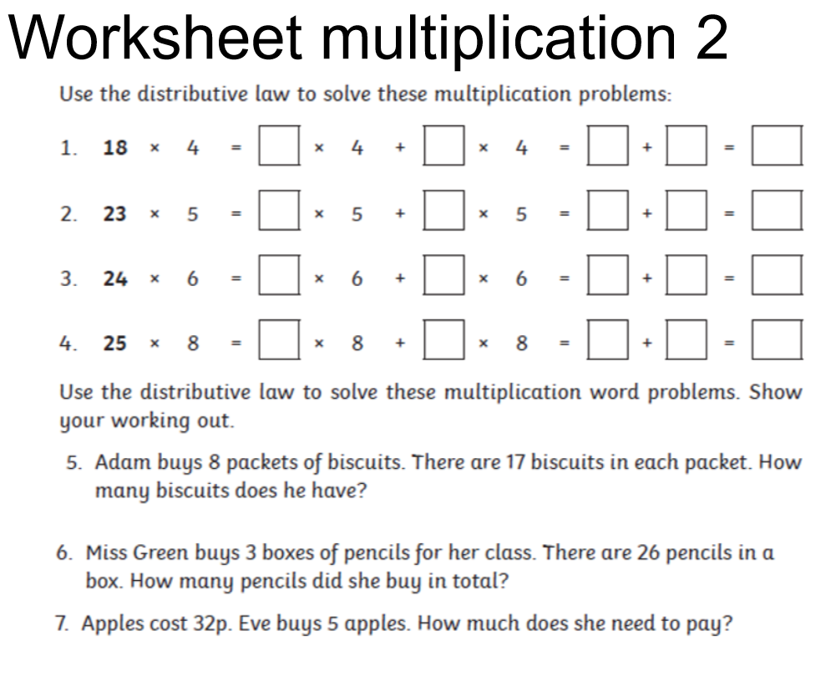

Slide 6


