Slide 1
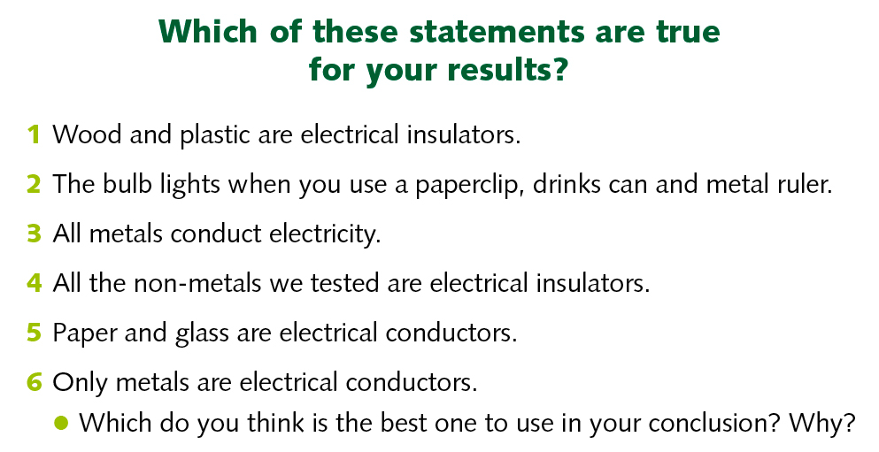
LO: To recognise some common conductors and insulators, and associate metals with being good conductors.
What have you found out about conductors and insulators?

Slide 2
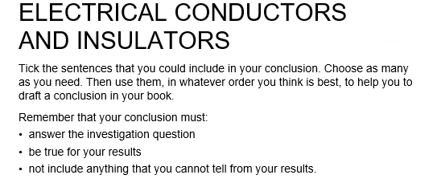
LO: To draw conclusions from an experiment.
Use your table of results and Venn diagram from last week.
What materials are good conductors and what materials are insulators?

Slide 3
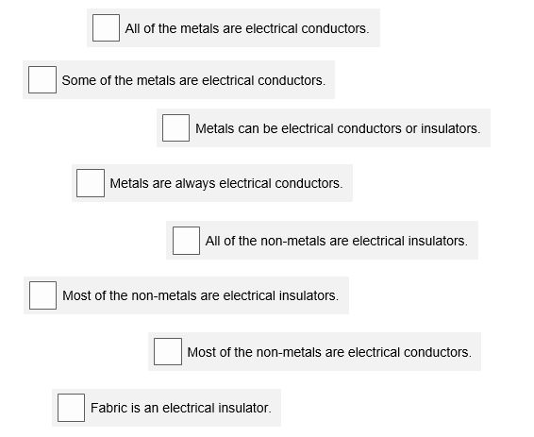
What materials are good conductors and what materials are insulators?

