Slide 1
You can repeat the Bus stop method and answer the following questions if you found this tricky yesterday (instead of moving onto remainders).
Year 3: Year 4:
42÷2= 642÷2=
96÷3= 396÷3=
48÷3= 189÷9=
68÷4= 288÷6=
75÷5= 336÷8=

Slide 2
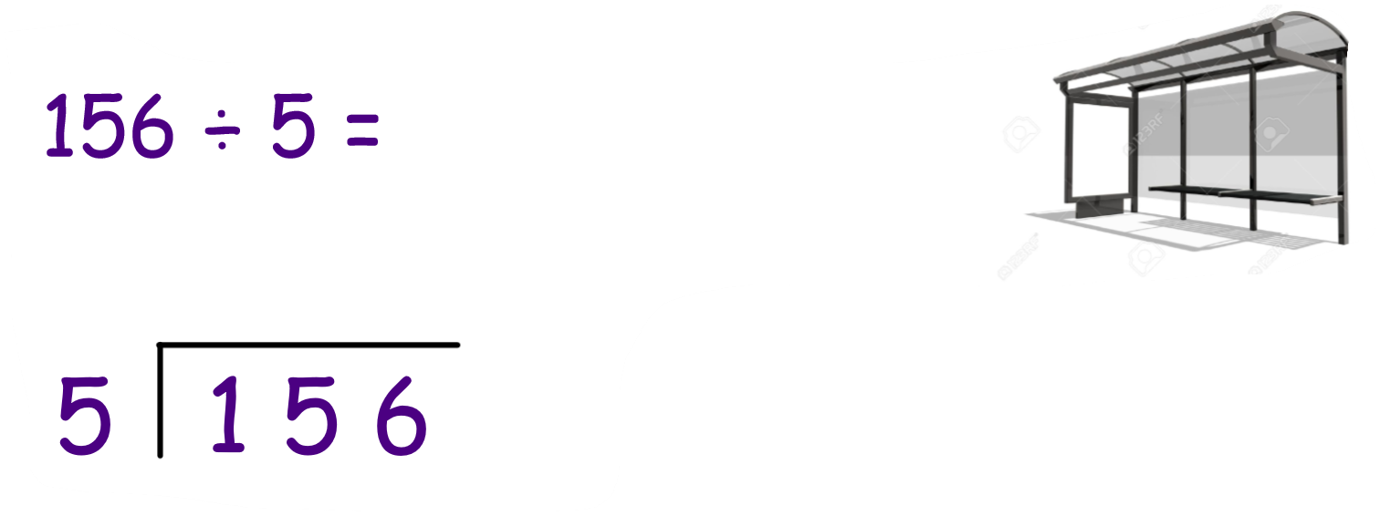
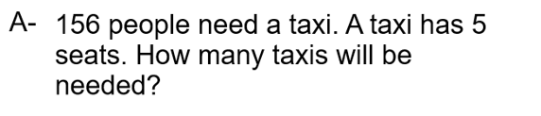
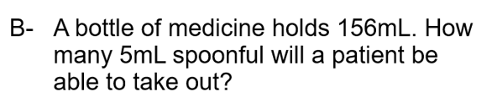
Lo: I can divide with remainders
What would you do if the problem was:

Slide 3
Division with remainders.
91 ÷5 =
84 ÷ 6 =

Slide 4
Division with remainders
101 ÷ 4=
289 ÷ 7 =

Slide 5
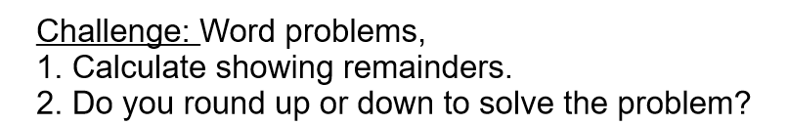
Now for a challenge…
To solve division word problems.

Slide 6
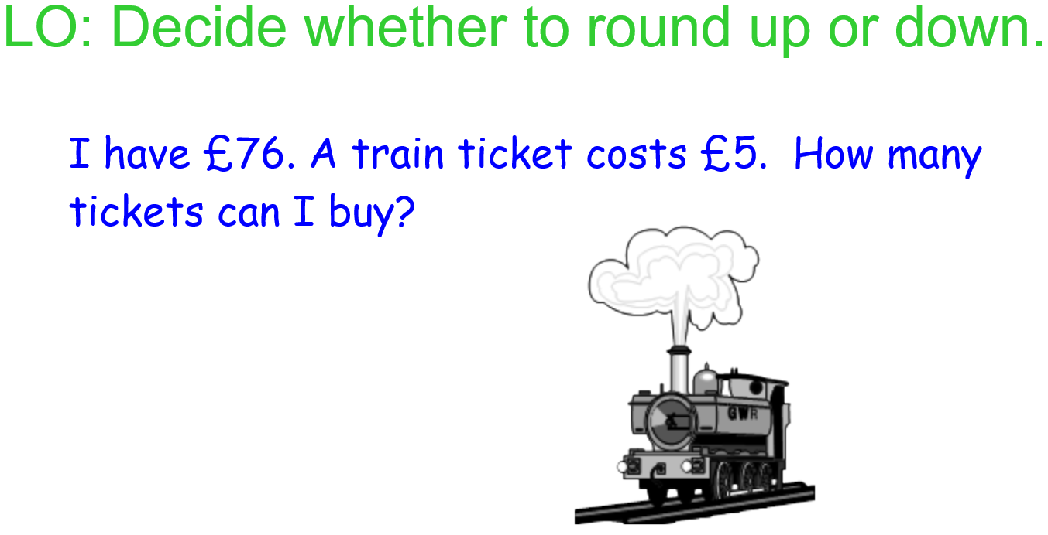

Slide 7
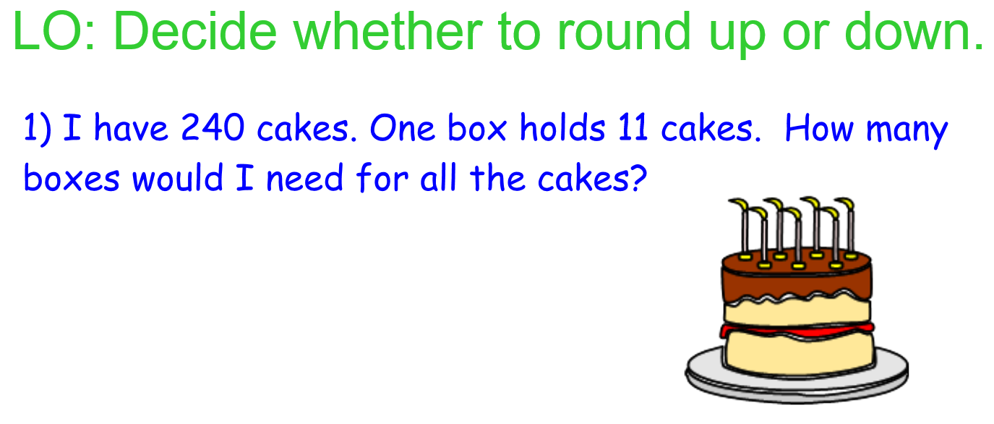

Slide 8
Activity time
Complete the activity for your year group on the worksheet Division 3.
Remember, if you are finding remainders tricky, you can choose to complete the bus stop method questions I spoke about at the start of the video/this presentation instead. You can also find these questions on the Division 3 worksheet.

