Slide 1
Fantasy stories:
Lo: to identify the structure of a fantasy story.

Slide 2
What is a fantasy story?
Fantasy is a genre of fiction that typically, taking inspiration from myth and legend, is set in a fictional universe and features supernatural characters and mythical creatures.

Slide 3
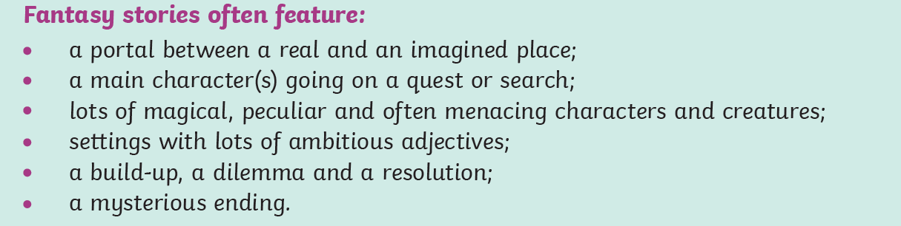
Dramatic settings (castles, mountains, forest)
Mystery
Magic
Mythical creatures

Slide 4
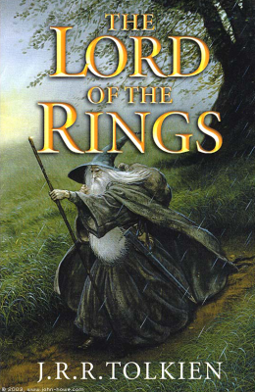
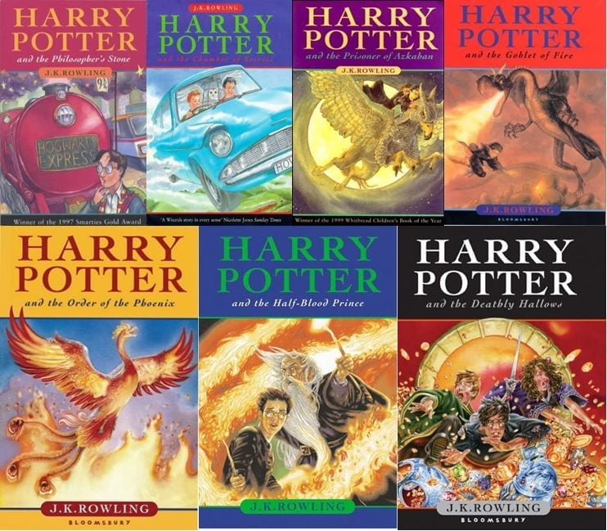
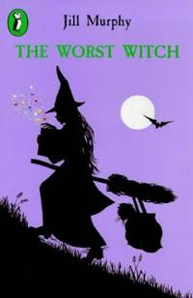
What fantasy stories do you know?

Slide 5
Alice in wonderland
Meeting the rabbit and falling down the hole:
https://www.youtube.com/watch?v=Q93VrYOXSe8
The mad hatters tea party:
https://www.youtube.com/watch?v=msvOUUgv6m8

Slide 6
Now read the story: https://www.youtube.com/watch?v=I8RRBQZEMdM with the Story Teller

Slide 7
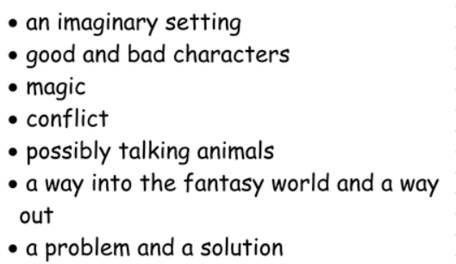
Why is it a fantasy story?

Slide 8
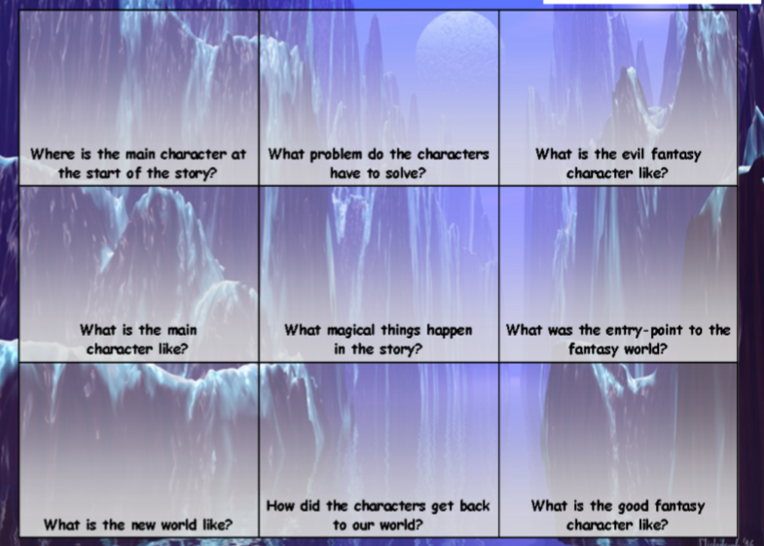
Create your own fantasy story ideas.

Slide 9
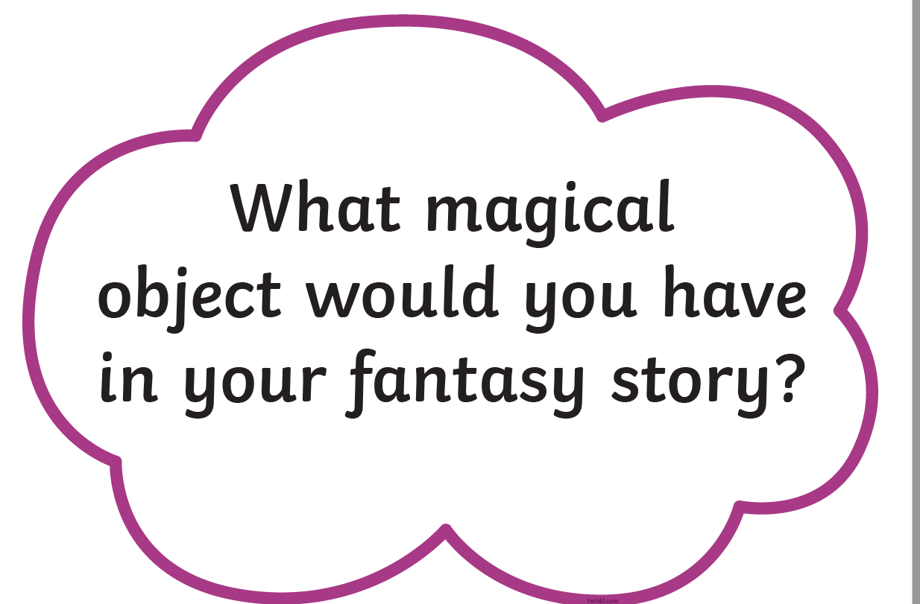

Slide 10
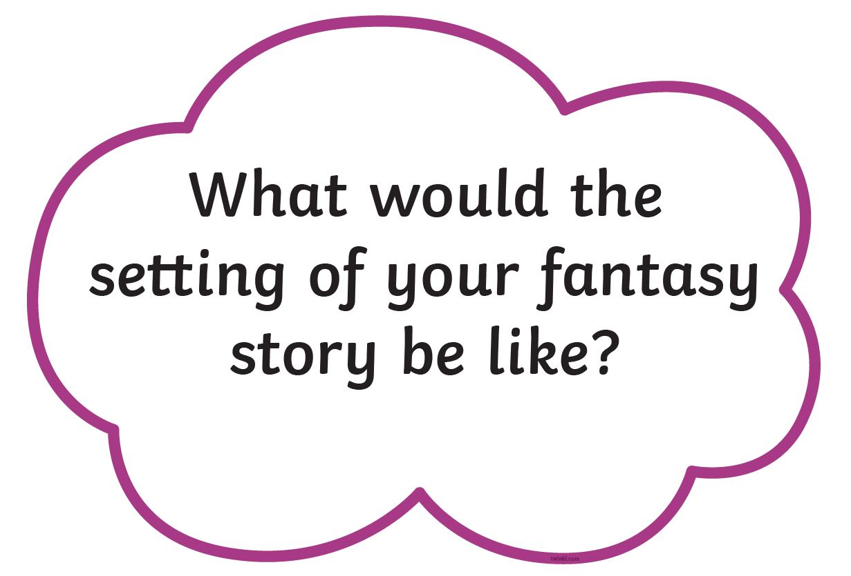

Slide 11
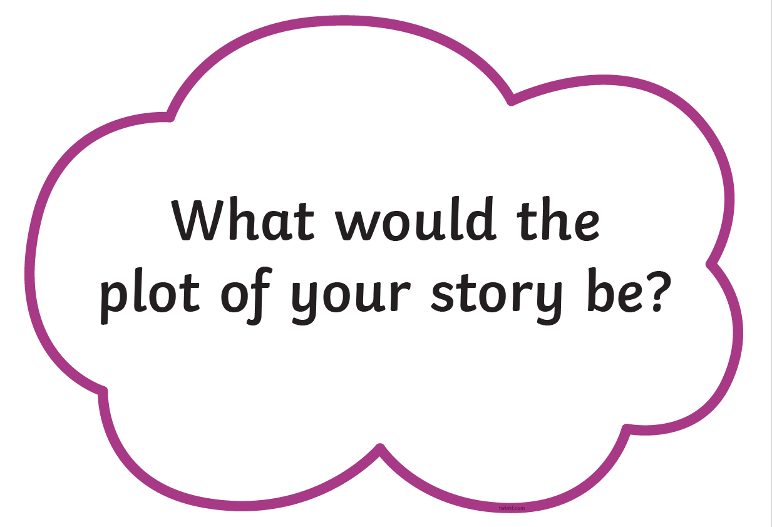

Slide 12
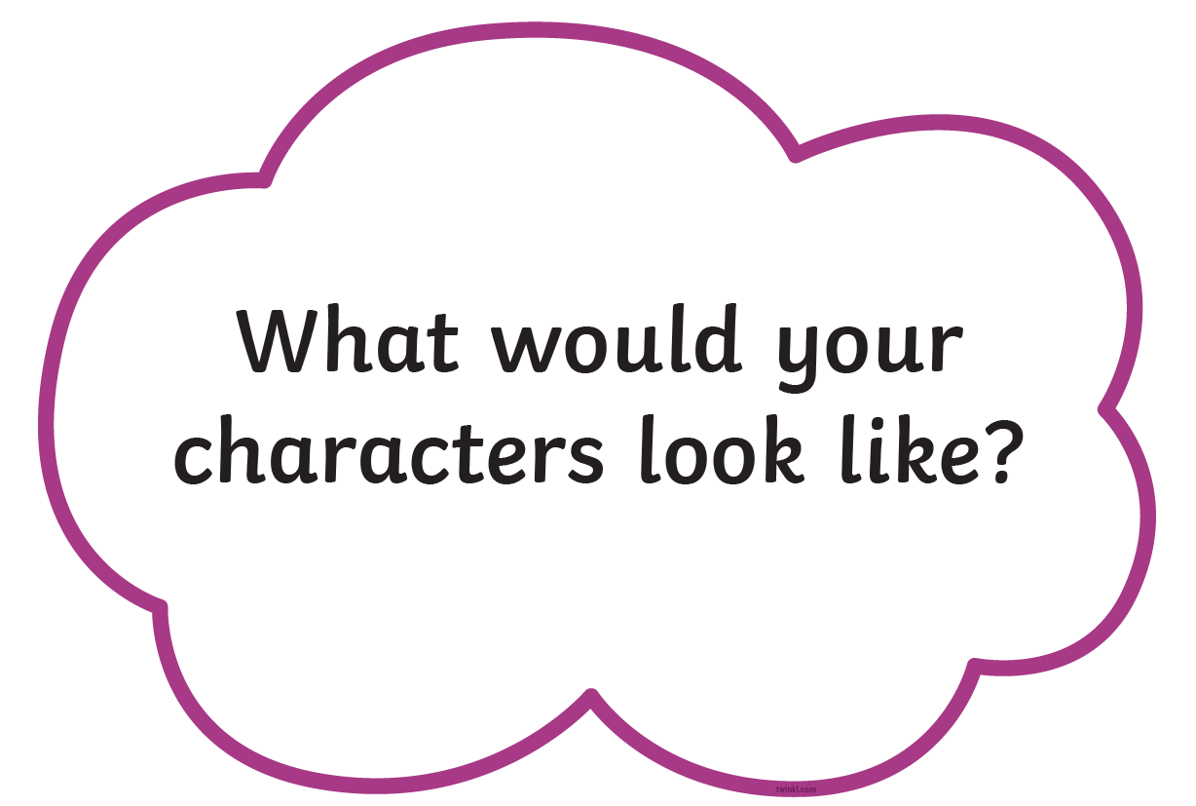

Slide 13
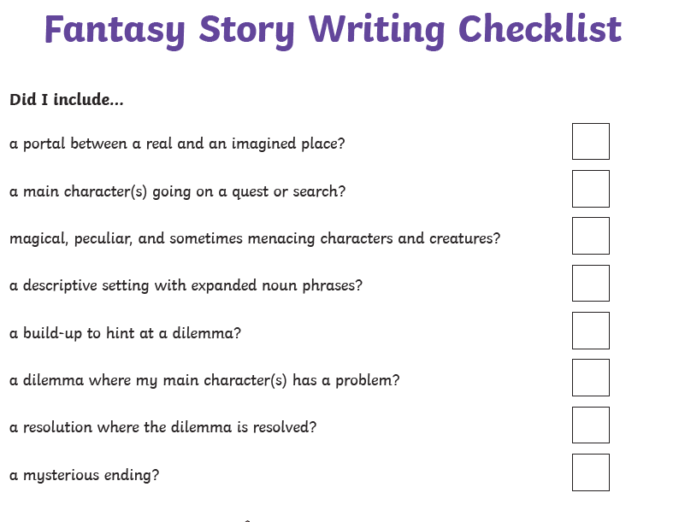
Fantasy story writing checklist

Slide 14
Activity task
Use the fantasy story checklist and generating ideas sheet to come up with your own fantasy story ideas.
Write or draw your ideas down.

