Slide 2

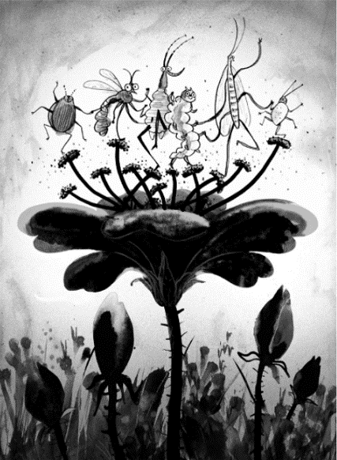



Beastie Besties
Look at this great illustration by Sara Ogilvie.
Click on each member of the Totally Pawsome Gang and help them to read the picture.
Vocabulary Victor
Inference Iggy
Rex Retriever
Vocabulary Victor wants to know…
What word could you use to
describe the bugs?
Back to Menu
Answers
Beastie Besties
Copyright © Sara Ogilvie 2020

Slide 3


Beastie Besties
Look at this great illustration by Sara Ogilvie.
Click on each member of the Totally Pawsome Gang and help them to read the picture.
Vocabulary Victor
Inference Iggy
Rex Retriever
Inference Iggy wants to know…
Why do you think that the flower looks so big?
Back to Menu
Answers
Beastie Besties
Copyright © Sara Ogilvie 2020

Slide 4

Beastie Besties
Look at this great illustration by Sara Ogilvie.
Click on each member of the Totally Pawsome Gang and help them to read the picture.
Vocabulary Victor
Inference Iggy
Rex Retriever
Rex Retriever wants to know…
What are the bugs doing?
Back to Menu
Answers
Beastie Besties
Copyright © Sara Ogilvie 2020

Slide 5



Beastie Besties Answers
Click on each card to reveal an example answer.
Vocabulary Victor
Inference Iggy
Rex Retriever
What word could
you use to describe the bugs?
Why do you think that the flower looks so big?
What are the
bugs doing?
Reveal Answer
I think that the flower looks so big because the bugs are tiny so the illustrator has had to zoom in on them.
The bugs are dancing on top of a flower.
I could use the word ‘lively’ to describe the bugs.
Reveal Answer
Reveal Answer
Back to Menu
Beastie Besties
Copyright © Sara Ogilvie 2020

Slide 6
Beastie Besties
Back to Menu
Zoom Out
Beastie Besties
Copyright © Sara Ogilvie 2020

