Slide 2

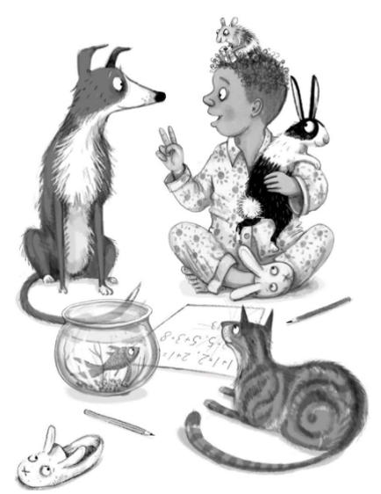



New Classmates
Look at this great illustration by Emily Gravett.
Click on each member of the Totally Pawsome Gang and help them to read the picture.
Rex Retriever
Predicting Pip
Vocabulary Victor
Rex Retriever wants to know…
What is happening in this picture?
Back to Menu
Answers
New Classmates
Copyright © Emily Gravett 2020

Slide 3


New Classmates
Look at this great illustration by Emily Gravett.
Click on each member of the Totally Pawsome Gang and help them to read the picture.
Rex Retriever
Predicting Pip
Vocabulary Victor
Predicting Pip wants to know…
If the dog could speak, what might it say next?
Back to Menu
Answers
New Classmates
Copyright © Emily Gravett 2020

Slide 4

New Classmates
Look at this great illustration by Emily Gravett.
Click on each member of the Totally Pawsome Gang and help them to read the picture.
Rex Retriever
Predicting Pip
Vocabulary Victor
Vocabulary Victor wants to know…
What word might an author use to describe the mouse?
Back to Menu
Answers
New Classmates
Copyright © Emily Gravett 2020

Slide 5



New Classmates Answers
Click on each card to reveal an example answer.
Rex Retriever
Predicting Pip
Vocabulary Victor
What is happening in this picture?
If the dog could speak, what might it say next?
What word might
an author use to describe the mouse?
In the picture, it looks like a child is teaching their pets how to answer maths problems.
I think that the dog would say, “Wow, you are so clever!”
An author might use the word ‘tiny’ to describe the mouse because it is very small.
Reveal Answer
Reveal Answer
Reveal Answer
Back to Menu
New Classmates
Copyright © Emily Gravett 2020

Slide 6
New Classmates
Back to Menu
Zoom Out
New Classmates
Copyright © Emily Gravett 2020

