Slide 1


Maths
Multiplication and Division
Year One
Maths | Year 4 | Multiplication and Division | Written Methods of Multiplication | Lesson 1 of 2: Short Multiplication with Two-Digit Numbers

Slide 2
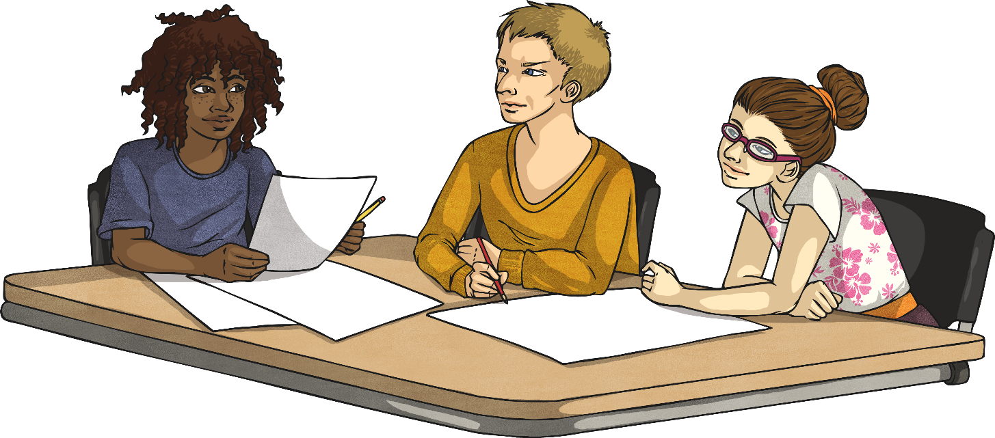

Short Multiplication with Two-Digit Numbers

Slide 3
Aim
I can use the short method of multiplication to multiply two-digit numbers by one-digit numbers. (3-digit numbers for year 4s)
Success Criteria
I can set my calculation out correctly.
I start at the right-hand side when calculating, multiplying the ones and then the tens.
I can regroup tens and hundreds and record this in the next column.

Slide 4
Expanded Multiplication
 | 9 | 3
x |  | 6
Do you remember how to use the expanded method of multiplication?
1
8
Work out 3 × 6 and write the answer here.
5
4
0
Work out 90 × 6 and write the answer here.
Add them together and write your answer here.
5
5
8

Slide 5
Short Multiplication
We are going to learn how to multiply using a faster method.

Slide 6

Short Multiplication
H
T
O
First set your calculation out correctly with one number in each square. Use a ruler to draw your lines.
 | 5 | 1
× |  | 9
Calculate the ones digit.
Multiply 1 by 9.
1 × 9 = 9 ones.
Write this in the ones column.
4
5
9
Now calculate the tens digit.
Multiply 5 tens by 9.
5 × 9 = 45 tens = 450.
Write the tens digit in the tens column.
Write the hundreds digit in the hundreds column.

Slide 7
Short Multiplication
Start at the right-hand side when calculating and multiplying the ones and tens.
H
T
O
H
T
O
 | 3 | 2
× |  | 4
 | 6 | 1
× |  | 7
1
2
8
4
2
7

Slide 8

Regrouping
H
T
O
First set your calculation out correctly with one number in each square. Use a ruler to draw your lines.
 | 4 | 6
× |  | 8
Calculate the ones digit.
6 × 8 = 48.
We can only put ones in the ones column. Write 8 here.
We need to regroup the 40 ones into 4 tens. These go into the tens column. Write 4 under the line.
3
6
8
Now calculate the tens digit.
4 tens × 8 = 32 tens = 320.
We need to add on the 4 tens that we wrote under the line. This makes 36 tens. Write 6 in the tens column.
4
This leaves us with 30 tens, or 3 hundreds. Write 3 in the hundreds column.

Slide 9
Regrouping
First set your calculation out correctly with one number in each square. Use a ruler to draw your lines.
Calculate the ones.
Regroup any tens in the answer and write them in the tens column under the line.
Now calculate the tens.
Don’t forget to add on any tens that you wrote underneath the line when you regrouped.

Slide 10
Regrouping
H
T
O
H
T
O
 | 8 | 6
× |  | 6
 | 5 | 6
× |  | 9
5
1
6
5
0
4
3
5

Slide 11

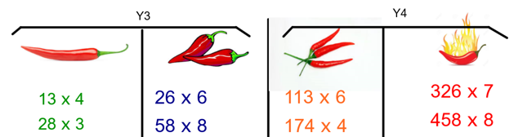
Multiplication Activities
Use the written method you are the most comfortable with and solve two of the following:
Then solve the multiplication problems.

