Slide 2

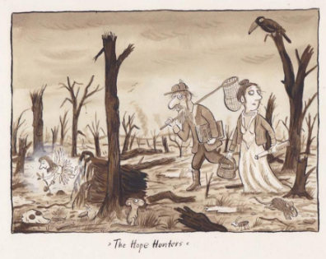
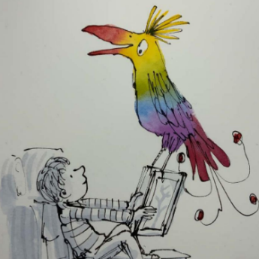
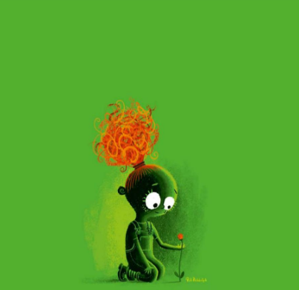
Read My Picture
Which Picture Shall We Read Today?
The Hope Hunters
Bird
Wherever a Flower Blooms
i
Click on one of the pictures to get started.
Finish

Slide 3
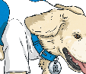

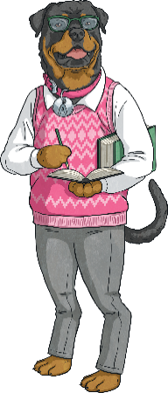
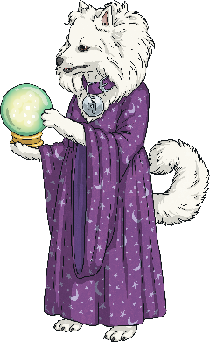
The Hope Hunters
Look at this fantastic illustration by Axel Scheffler.
i
Next
Click on each member of the Totally Pawsome Gang and help them to read the picture.
Rex Retriever wants to know…
If the illustrator drew another picture of the Hope Hunters after this one, what do you think they would show in it?
Why do you think that the illustrator has called this picture ‘The Hope Hunters’?
Arlo the Author wants to know…
Where are the two people?
Predicting Pip wants to know…
Back to Menu
Answers
The Hope Hunters
Copyright © Axel Scheffler 2020

Slide 4
The Hope Hunters
Back to Menu
Zoom Out
The Hope Hunters
Copyright © Axel Scheffler 2020

Slide 5
The Hope Hunters Example Answers
Q
Q
Why do you think that the illustrator has called this picture ‘The Hope Hunters’?
If the illustrator drew another picture of the Hope Hunters after this one, what do you think they would show in it?
Look at this fantastic illustration by Axel Scheffler.
Q
Where are the two people?
A
I think that the author has called the picture ‘The Hope Hunters’ because they are looking for hope in a place that doesn’t seem very hopeful.
A
I think that the picture would show the two people trying to catch the fairy with the net while the fairy is trying to get away.
i
A
The two people are in a forest that is full of broken trees.
Click on each member of the Totally Pawsome Gang to see their answer.
Rex Retriever’s answer is…
Arlo the Author’s answer is…
Predicting Pip’s answer is…
Back to Menu
The Hope Hunters
Copyright © Axel Scheffler 2020

Slide 6



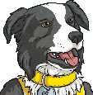
Bird
Look at this great illustration by Sam Usher.
i
Next
Click on each member of the Totally Pawsome Gang and help them to read the picture.
Vocabulary Victor wants to know…
What do you think the child is reading about? What makes you think that?
Using 20 words or fewer, can you tell your friend what is happening in this picture?
What three words could you use to describe
the bird?
Inference Iggy wants to know…
Summarising Sheba wants to know…
Back to Menu
Answers
Bird
Copyright © Sam Usher 2020

Slide 7
Bird
Back to Menu
Zoom Out
Bird
Copyright © Sam Usher 2020

Slide 8
Bird Example Answers
Q
Q
Q
What do you think the child is reading about? What makes you think that?
Using 20 words or fewer, can you
tell your friend what is happening
in this picture?
What three words could you use to describe the bird?
Look at this great illustration by Sam Usher.
A
I think that the child is reading about animals that live in trees because there is a picture of a tree on the book and they are imagining a huge, colourful bird.
A
Someone is reading lots of books and is imagining that a giant, colourful bird is sitting on one of them.
i
A
I could use the words ‘colourful’, ‘magnificent’ and ‘surprising’ to describe the bird.
Click on each member of the Totally Pawsome Gang to see their answer.
Vocabulary Victor’s answer is…
Inference Iggy’s answer is…
Summarising Sheba’s answer is…
Back to Menu
Bird
Copyright © Sam Usher 2020

Slide 9


Wherever a Flower Blooms
Look at this amazing illustration by Rob Biddulph.
i
Next
Click on each member of the Totally Pawsome Gang and help them to read the picture.
Predicting Pip wants to know…
What do you think the child is thinking about? What makes you think that?
Comment on why you think the illustrator has only used a few colours.
Inference Iggy wants to know…
What do you think that the child will do next?
Cassie the Commentator wants you to…
Back to Menu
Answers
Wherever a Flower Blooms
Copyright © Rob Biddulph 2020

Slide 10
Wherever a Flower Blooms
Back to Menu
Zoom Out
Wherever a Flower Blooms
Copyright © Rob Biddulph 2020

Slide 11
Wherever a Flower Blooms Example Answers
Q
Q
Q
What do you think that
the child will do next?
Comment on why you think the illustrator has only used a few colours.
What do you think the child is thinking about? What makes you think that?
Look at this amazing illustration by Rob Biddulph.
A
I think that the illustrator has only used a few colours so that you notice the flower even though it is a really tiny part of the picture.
A
I think that the child is thinking about how pretty the flower is going to look when it blooms because they look really happy and they are being gentle with the flower.
A
I think that the child will water the flower to try and help it to grow.
i
Click on each member of the Totally Pawsome Gang to see their answer.
Predicting Pip’s answer is…
Inference Iggy’s answer is…
Cassie the Commentator’s answer is…
Back to Menu
Wherever a Flower Blooms
Copyright © Rob Biddulph 2020

