Slide 1
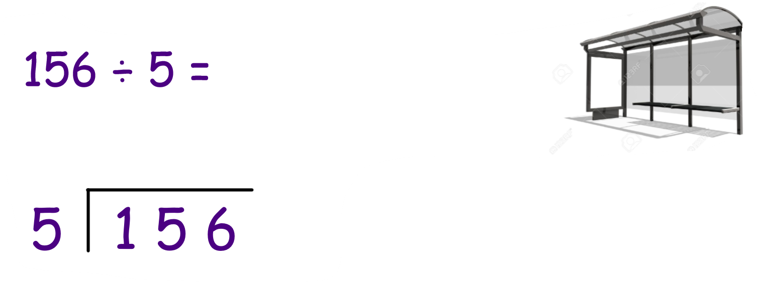


Division with remainders
What would you do if the problem was:

Slide 2
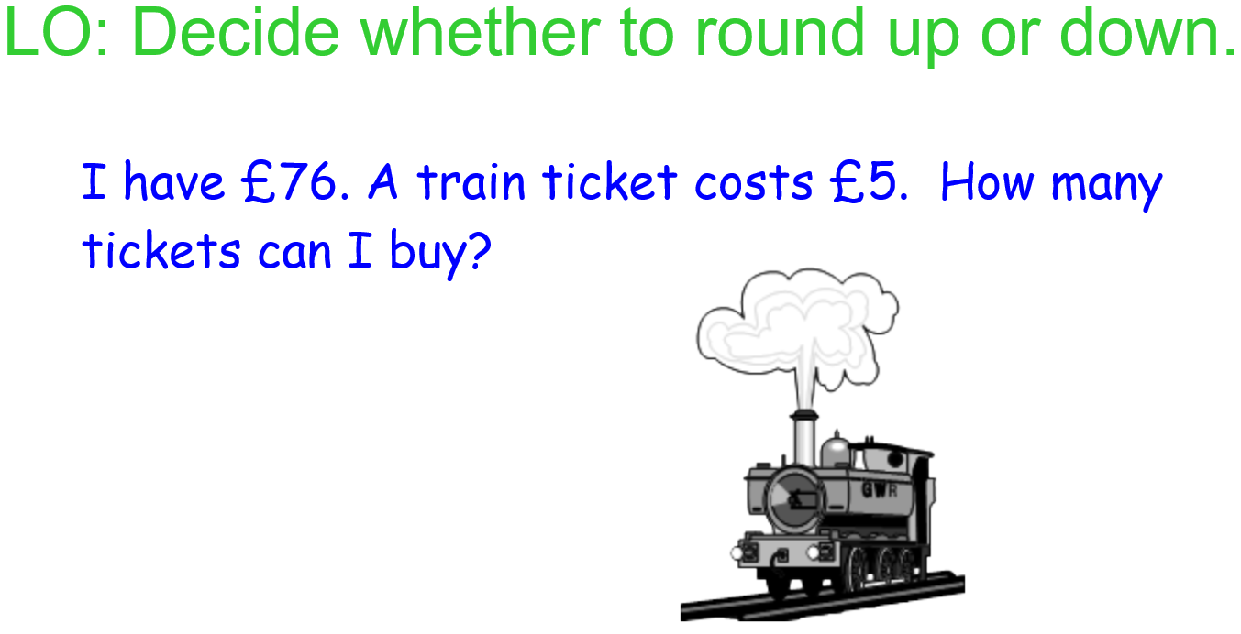

Slide 3
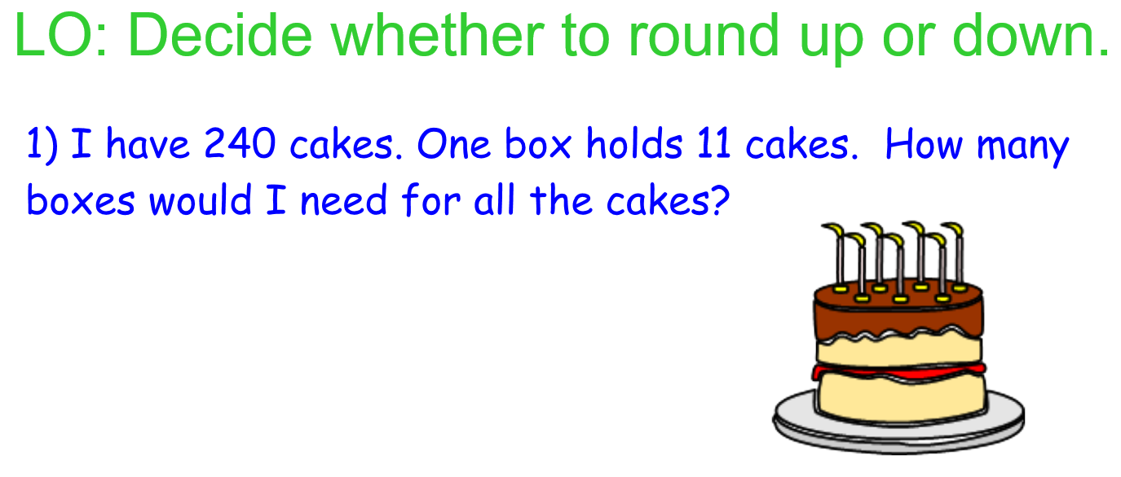

Slide 4


