Slide 1
LO: I can divide using the bus stop method.

Slide 2
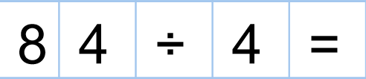
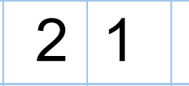
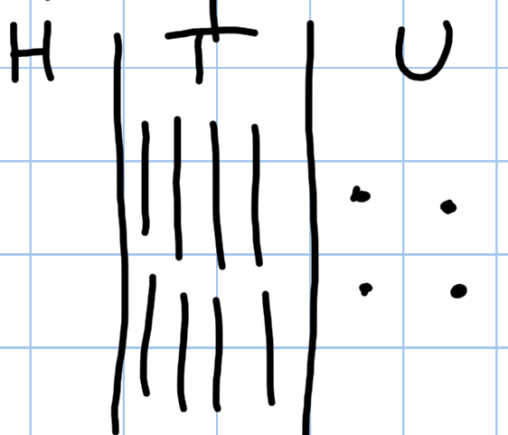
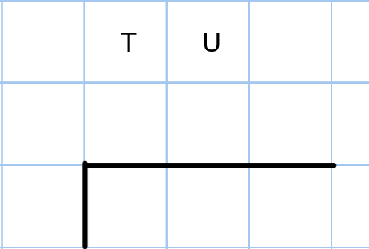
LO: I can divide using the bus stop method.
84 in groups of 4 is :
2
1
4
8 4

Slide 3
LO: I can divide using the bus stop method.
24
48 ÷ 2 =
2
4
2
4
8
How many 2’s are there in 8?
How many 2s are there in 4?
How many are left over?
Great!

Slide 4
LO: I can divide using the bus stop method.
Let’s look at some more examples
together.

Slide 5
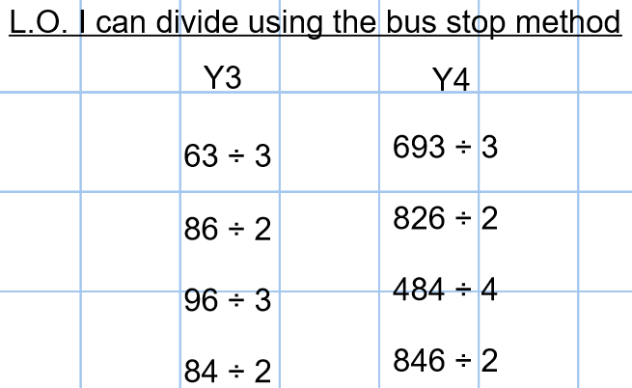
Activity time:

Slide 6
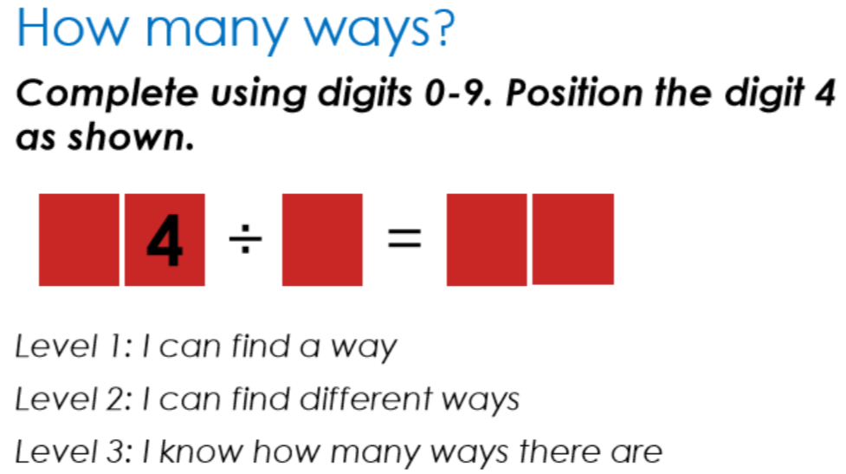
Challenge:

