Slide 1
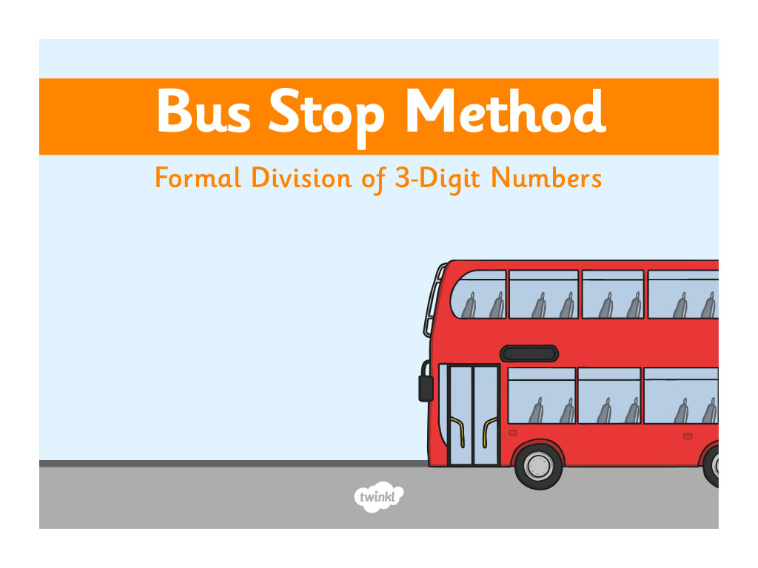

Slide 2
LO: I can divide using the bus stop method.
The bus stop method involves carrying over numbers.

Slide 3
38
76 ÷ 2 =
3
8
2
7
1
6
How many 2s are there in 7?
How many 2’s are there in 16?
How many are left over?
Great!

Slide 4
13
65 ÷ 5 =
1
3
5
6
1
5
How many 5’s are there in 15?
How many 5s are there in 6?
How many are left over?
Great!

Slide 5
29
145 ÷ 5 =
0
2
9
5
1
1
4
4
5
How many are left over?
How many 5s are there in 1?
Great!
How many 5’s are there in 14?
How many 5s are there in 45?
How many are left over?

Slide 6
134
670 ÷ 5 =
1
3
4
5
6
1
7
2
0
How many are left over?
How many 5s are there in 20?
How many 5s are there in 6?
Great!
How many 5’s are there in 17?
How many are left over?

Slide 7
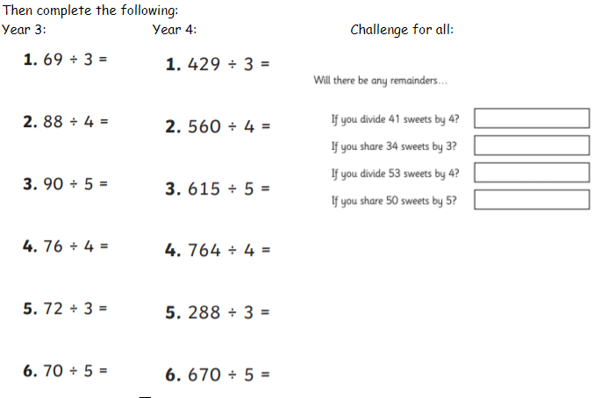
ACTIVITY

Slide 8


