Slide 1

The abcDe of…
@Unicef/Fields
Notes:
Image: Unicef/Fields

Slide 2

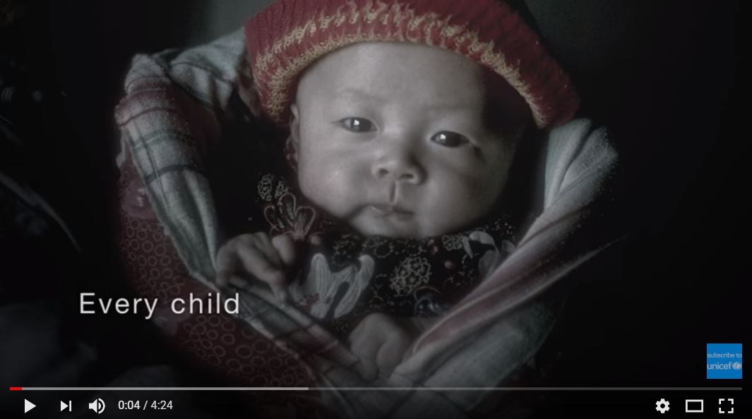
A: Rights are for ALL children
Key idea: Rights are for all children and young people across the world.
Key word: Universal
Notes:
Image: Unicef

Slide 3
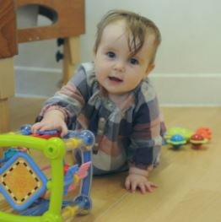
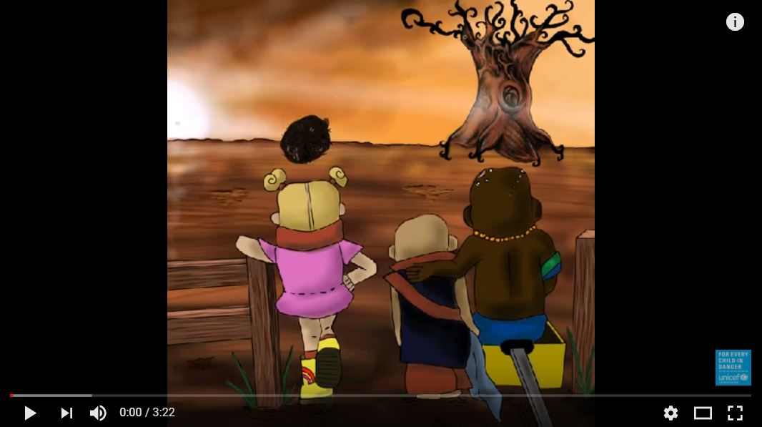
B: Rights are there at birth
Key idea: Humans are born with rights.
Key word: Inherent
0 18
Unicef UK/Mead
Notes:
Image: Unicef UK/Mead

Slide 4

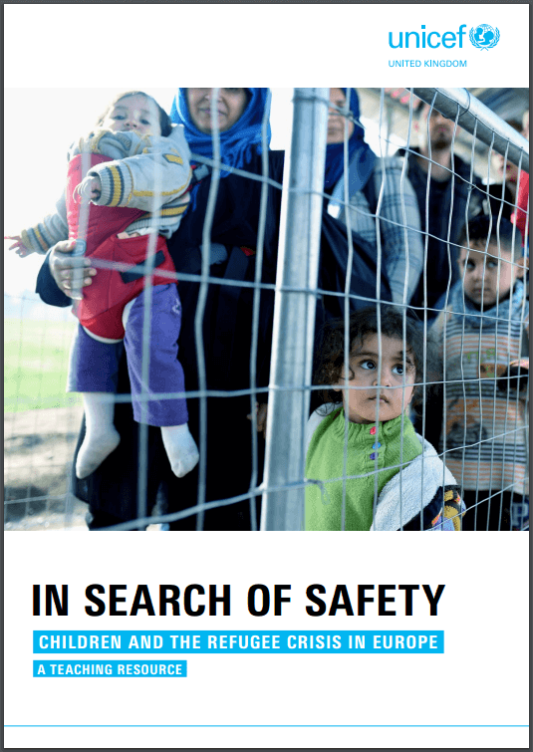
c: Rights CANNOT BE TAKEN AWAY
Key idea: Rights cannot be given, taken away, bought or sold
Key word: Inalienable
In Search of Safety explores how the rights of child refugees have been affected by conflict.
Find out more.
Notes:
Image: Wiki Commons

Slide 5

D: Rights do not have to be earnt
Key idea: Rights do not come with any conditions attached and are not linked to responsibilities as they are not earnt.
Key word: Unconditional
Notes:
Images: Unicef

Slide 6


E: All Rights Are equally important
Key idea: Every right is important in order for children and young people to survive, develop and reach their full potential. Rights are a whole package and are interlinked.
Key word: Indivisible
.
Notes:
Image left: Wiki Commons
Image right: Unicef resources

Slide 7
Thank you
Notes:
Image: UnicefUK/Sutton-Hibbert

