Slide 1

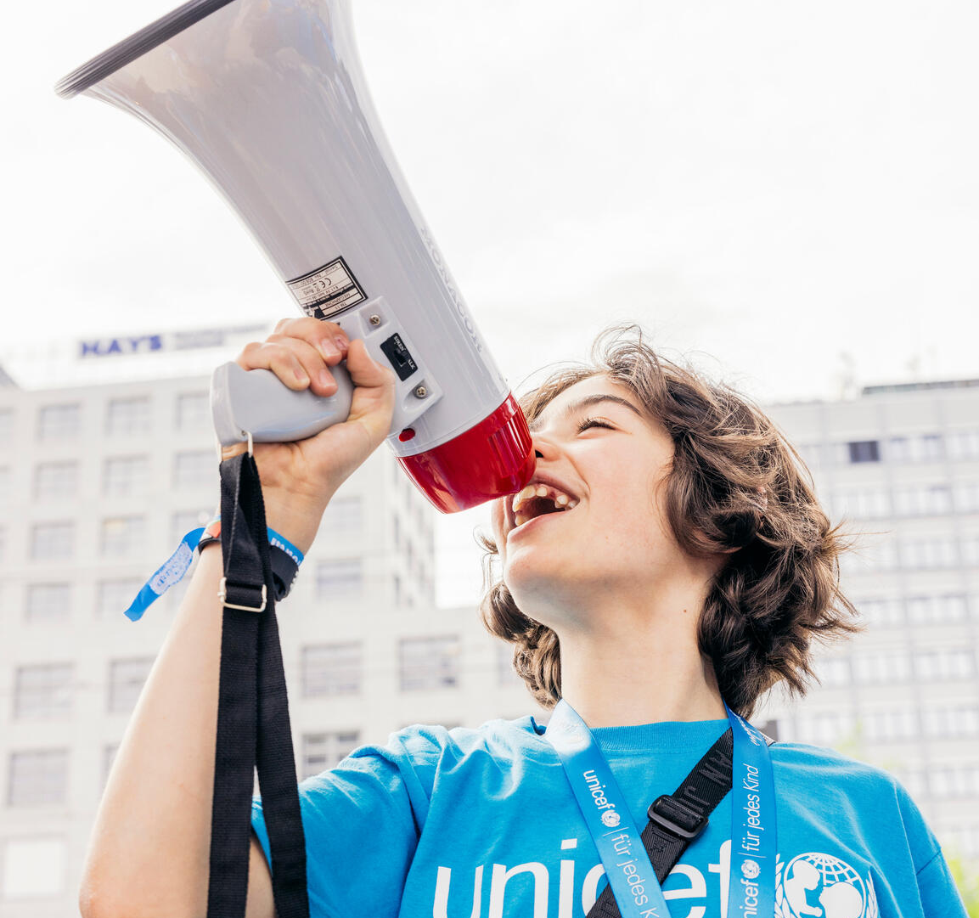

  Do you know your rights?
© UNICEF/Al-Safadi
Let’s check…
© UNICEF/Stroisch

Slide 2
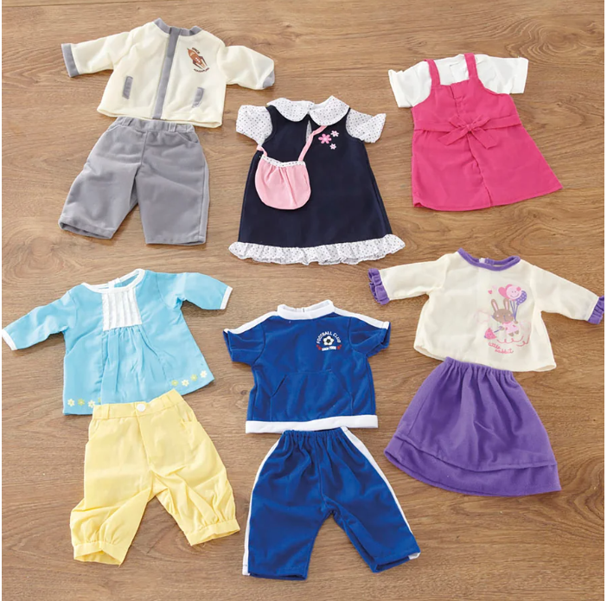
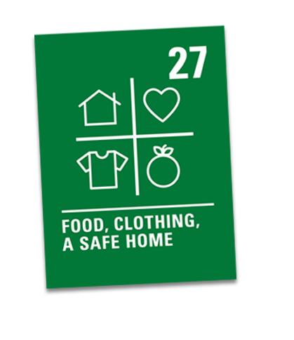
Dolls’ clothing
MATCH THE RIGHTS
FOOD,
CLOTHING,
SAFE ENVIRONMENT
© UNICEF/Dejongh
Notes:
(This could also relate, again, to Article 23: children with disabilities)

Slide 3
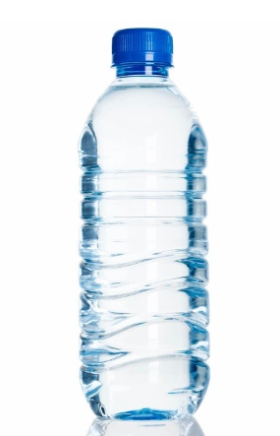
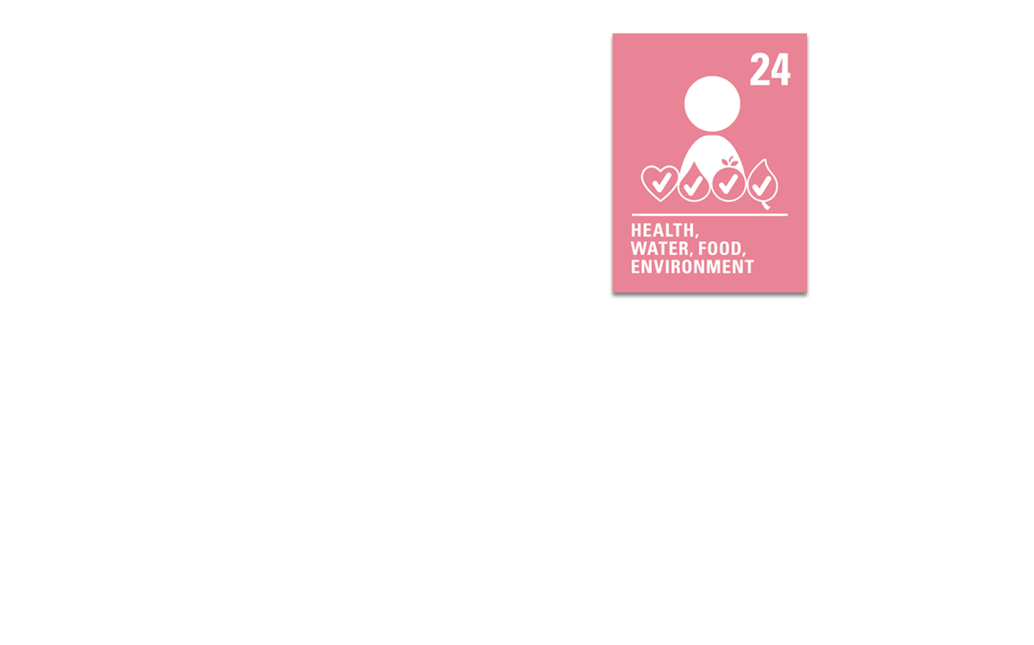
MATCH THE RIGHTS
Empty water bottle
CLEAN WATER
© UNICEF/Awad

Slide 4
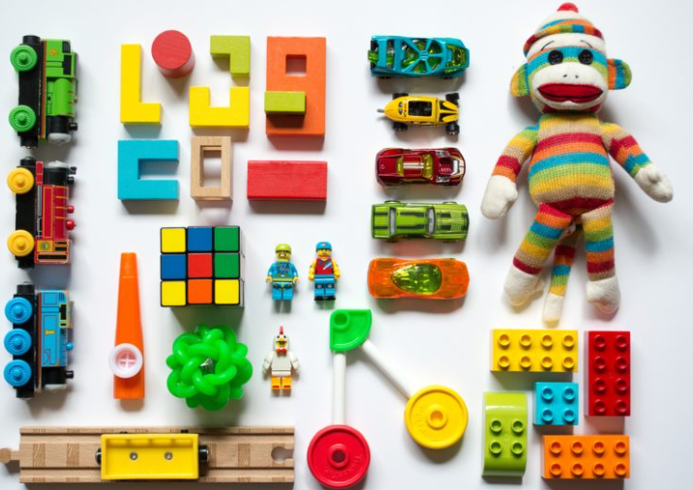
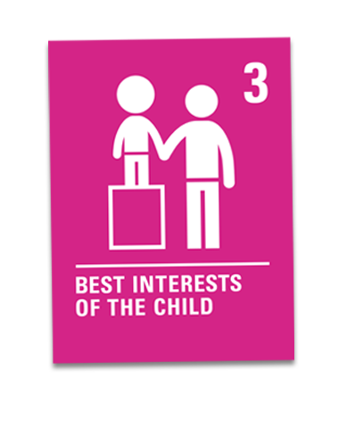
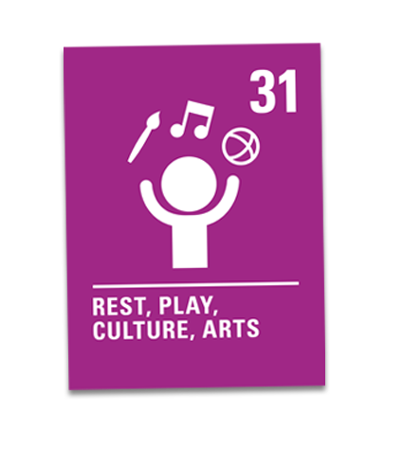
Small toy
MATCH THE RIGHTS
PLAY
© UNICEF/Elfatih

Slide 5
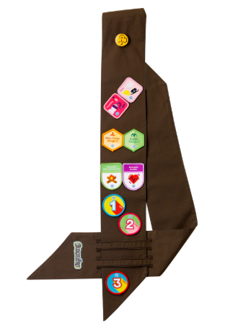

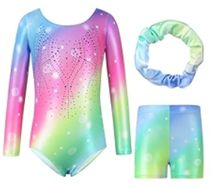

MATCH THE RIGHTS
Small item from a club you went to
JOINING GROUPS
© UNICEF/Sava

Slide 6
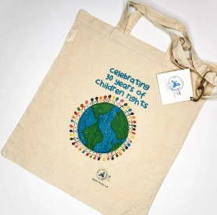

MATCH THE RIGHTS
Tote
bag
It’s not a right, but we do need a bag to carry all these items!
© UNICEF/Awad

