Slide 1

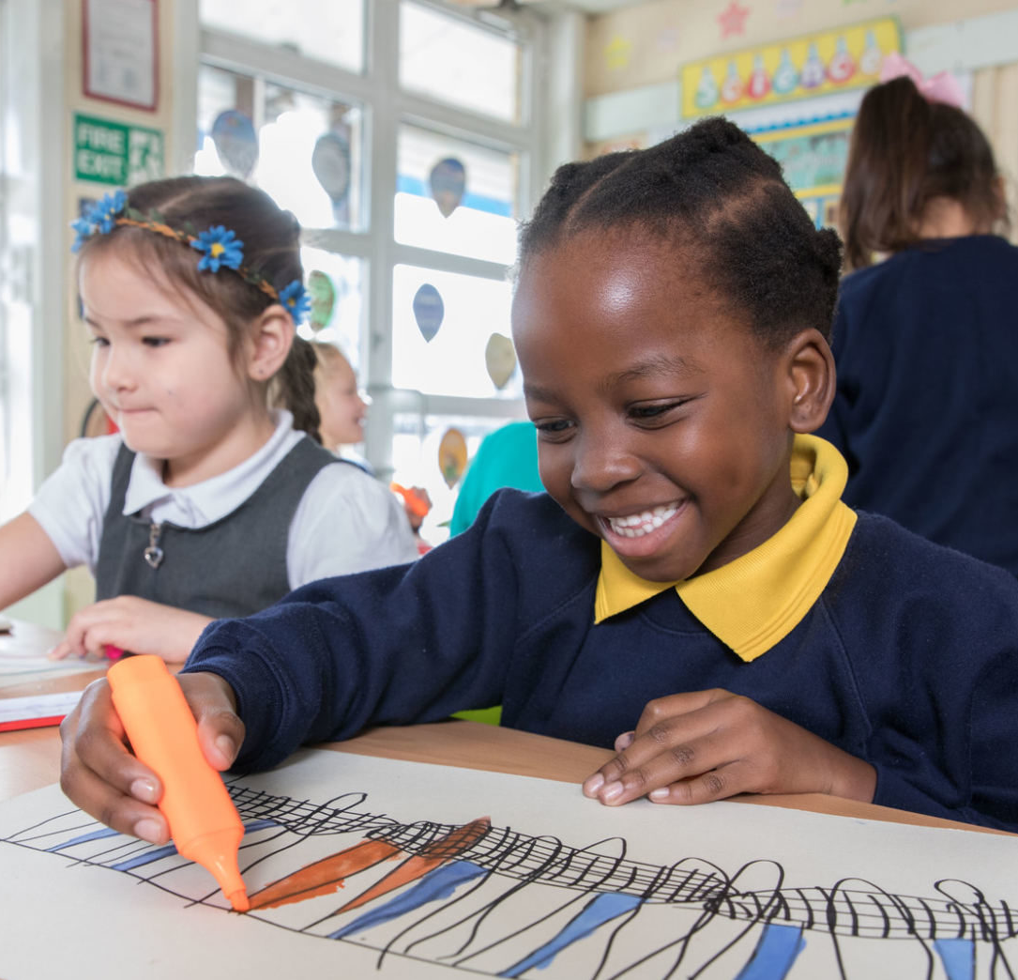

  ACTIVITY 2
  HOW IS
  THE UK
  PROTECTING
  CHILDREN’S
  RIGHTS?
© UNICEF/Al-Safadi
© UNICEF/Dawe
Students at a Gold Rights Respecting School in London.

Slide 2
UP OR
DOWN!

Slide 3
UP OR
DOWN!
The health service has a scheme to make sure all children get the immunisations they need to stay healthy.

Slide 4
  UP!
The health service has a scheme to make sure all children get the immunisations they need to stay healthy.

Slide 5
UP OR
DOWN!
Children in some regions aren't able to go to school.

Slide 6
Children in some regions aren't able to go to school.
  Down

Slide 7
UP OR
DOWN!
Pollution is hurting children’s health...
...but the government is making changes to create clean air laws.

Slide 8
Pollution is hurting children’s health...
  DOWN

Slide 9
  UP!
...but the government is making changes to create clean air laws.

Slide 10
UP OR
DOWN!
The government offers mental health care to children to keep children well...
...but services aren’t always available soon enough for everyone who needs them.

Slide 11
  UP!
The government offers mental health care to children to keep children well...

Slide 12
...but services aren’t always available soon enough for everyone who needs them.
  DOWN

Slide 13
UP OR
DOWN!
My community has many parks and green places for children to play.

Slide 14
  UP!
My community has many parks and green places for children to play.

Slide 15
UP OR
DOWN!
Children are getting sick because the water in one community is polluted and not safe to drink.

Slide 16
Children are getting sick because the water in one community is polluted and not safe to drink.
  DOWN

Slide 17
  Up or
  down?
Children are sharing their opinion by participating in a children’s parliament.

Slide 18
  UP!
Children are sharing their opinion by participating in a children’s parliament.

Slide 19
UP OR
DOWN!
MPs and local councillors ask for children’s opinions when making decisions that relate to them.

Slide 20
  UP!
MPs and local councillors ask for children’s opinions when making decisions that relate to them.

Slide 21
UP OR
DOWN!
The government is making decisions to protect the environment, so children have a better future...
...but costs and competing priorities mean the environment isn’t always put first.

Slide 22
  UP!
The government is making decisions to protect the environment, so children have a better future...

Slide 23
...but costs and competing priorities mean the environment isn’t always put first.
  DOWN

Slide 24
UP OR
DOWN!
Can you think of any examples from your local community, school...?

