Slide 1

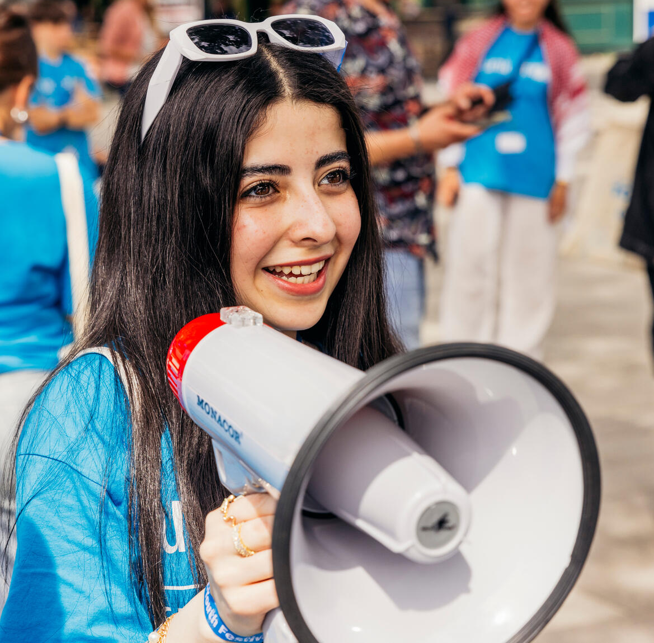

  ACTIVITY 3 – session 1
  ELECTIONS
  AND USING
  YOUR VOICE
  IN DEMOCRACY
© UNICEF/Al-Safadi
Jannat, 15, rallies people with a megaphone at the UNICEF Youth Festival, Mannheim, Germany.
© UNICEF/Stroisch

Slide 2
  How democracy works
Detailed video (KS2)
Shorter video (KS1)

Slide 3
  How democracy works
DEMOCRACY
DEFINITIONS:
A MATCHING
GAME

Slide 4
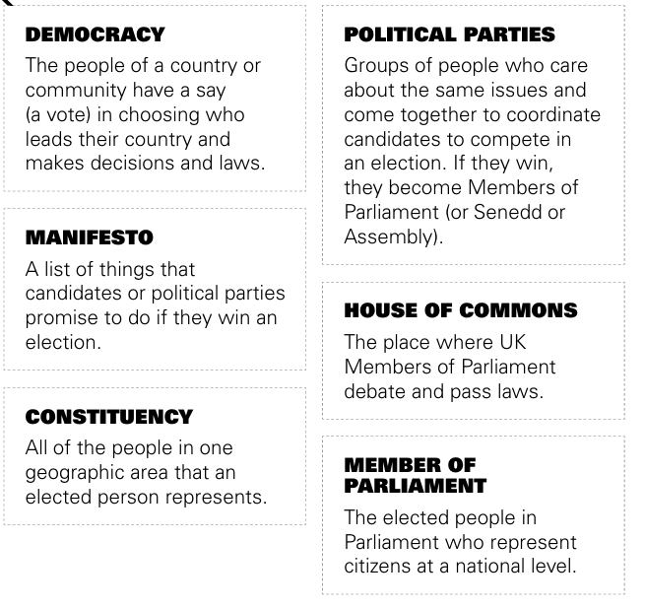
  How democracy works
Democracy
House of commons
Manifesto
Political parties
Member of parliament
Constituency

Slide 5
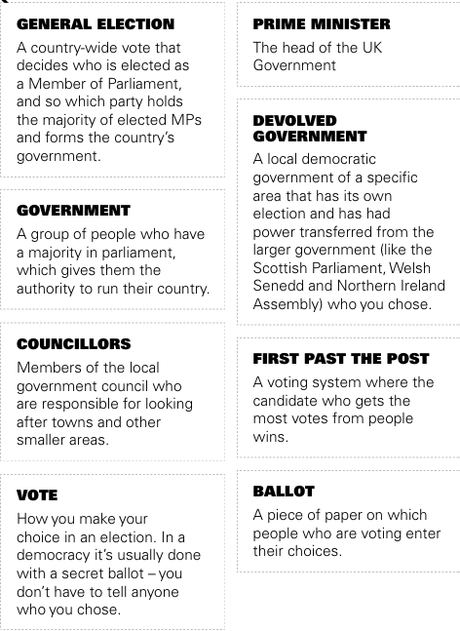
  How democracy works
Prime minister
Government
First past the post
Vote
Ballot
General election
Councillors
Devolved Government

Slide 6
  ACTIVITY 3 – session 2
  How is your voice heard in school?
© UNICEF/Al-Safadi
Jannat, 15, rallies people with a megaphone at the UNICEF Youth Festival, Mannheim, Germany.
© UNICEF/Stroisch

Slide 7
How is your voice heard in school?
Which decision have you been part of?
VOTE: I can influence decision in school?

