Slide 1


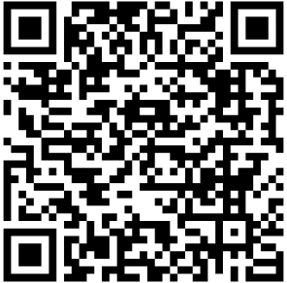
School Uniform Information Guide.
Swavesey Primary Academy
Scan the QR Code to find
the school page!
For delivery before Back to School, please order by:
Wednesday 13th August 2025

Slide 2
Dear Parents & Carers…
We always encourage parents to order as soon as possible to ensure you will have the correct uniform for Back to School. You will see the QR code to order your school uniform on the front page of this booklet. Our delivery times during our “peak season” are 10 working days however, these can be longer as we move closer to Back to School.
Our shop in Peterborough is open Monday to Friday 9am till 5pm. (during the summer holidays we open on Saturdays 10-4pm)
We are here to help you if you have any questions, please call our Schools Team on 01733 394758, contact us via live chat on our website or email customerservices@totalclothing.co.uk who will be happy to advise you.
Kind Regards
Abi, Christine, Janet, Mollie, Carol, Babs and Ryan
The School Teams, Total Clothing (part of F.R. Monkhouse Ltd)
Buying school uniform can be a tricky task, so here at Total Clothing we have created our School Uniform Information Guide to help you make the process easy for you.
Inside you will find:
Hints and tips on measuring to help you get the right fit first time.
How to place your school uniform order on-line – ensure you place by Wednesday 13th August to receive in time for Back to School.
Ways to get in touch with our Schools Team.
Our Top Uniform Tips.
Our shop location in Peterborough.

Slide 3





How to purchase your uniform…
How to purchase your uniform…
Click on the link in this guide or go to TotalClothing and find your school.
Click & collect from our shop or have your uniform delivered to your home.
Phone
Please call
01733 394758
Phone
Please call
01733 394758
Live Chat
Please visit our website
TotalClothing
Email
Please email directly customerservices@
totalclothing.co.uk
Returns policy:
We have a returns policy of 28 days from your purchase to return or exchange your garments. It would be great if you could send your returns as soon as possible to help our stock levels.
Returns policy:
We have a returns policy of 28 days from your purchase to return or exchange your garments. It would be great if you could send your returns as soon as possible to help our stock levels.
Where to purchase!

Slide 4

How to measure your child for school uniform…
Collar
Chest:
Place the tape measure under the arms and measure the chest at the fullest part.
Chest
Collar:
Measure around the base of the neck where the collar sits.
Waist
Hips:
Measure around the bottom, at the fullest part.
Inside Leg
Inside Leg:
Measure from the crotch to the top of the shoe.
Hips
Waist:
Measure around the natural waistline – where you would normally wear your trousers or skirt.

Slide 5








Our top uniform buying tips…
Sweatshirts:
Make sure you leave enough growing room in the body and arms.
All of our garments:
Are easy to wash and dry quickly.
Polo Shirts:
This is not a shaped garment and the polos are a generous fit. Choose the size relating to your child’s age.
PE Shorts:
These come in waist sizes 18/20” 22/24” 26/28” 30/32”. Choose the size that best fits your child’s waist measurement.
Please note…
All our polo shirts, sweatshirts and PE t-shirts come in age sizes. 3/4, 5/6, 7/8, 9/10, 11/12 and 13 years.
Knitted jumpers & cardigans:
These come in chest sizes, 26” 28” 30” 32” 34” please use your child’s chest measurements for these garments.
Remember…
You can also buy your accessories from us: book bags, PE bags, water bottles, hair accessories and plimsoles.
Don’t forget!
Iron on name labels to avoid uniform getting lost!

Slide 6
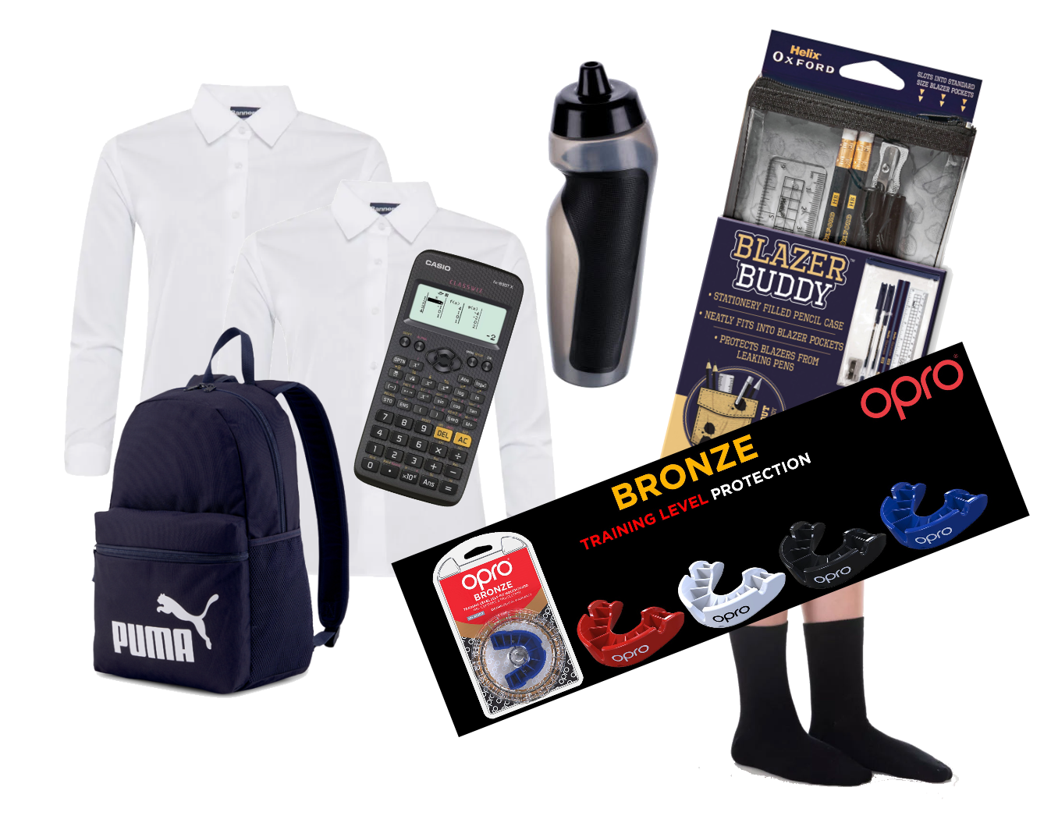
Did you know that we also sell all the Essential & Accessories you may need?
Backpacks
Helix Stationary
Calculators
Iron on Name Labels
Shirts & Blouses
Water Bottles
Gumshields
Shin Guards

Slide 7

Building a greener and fairer future…

Slide 8

Building a greener and fairer future…

Slide 9

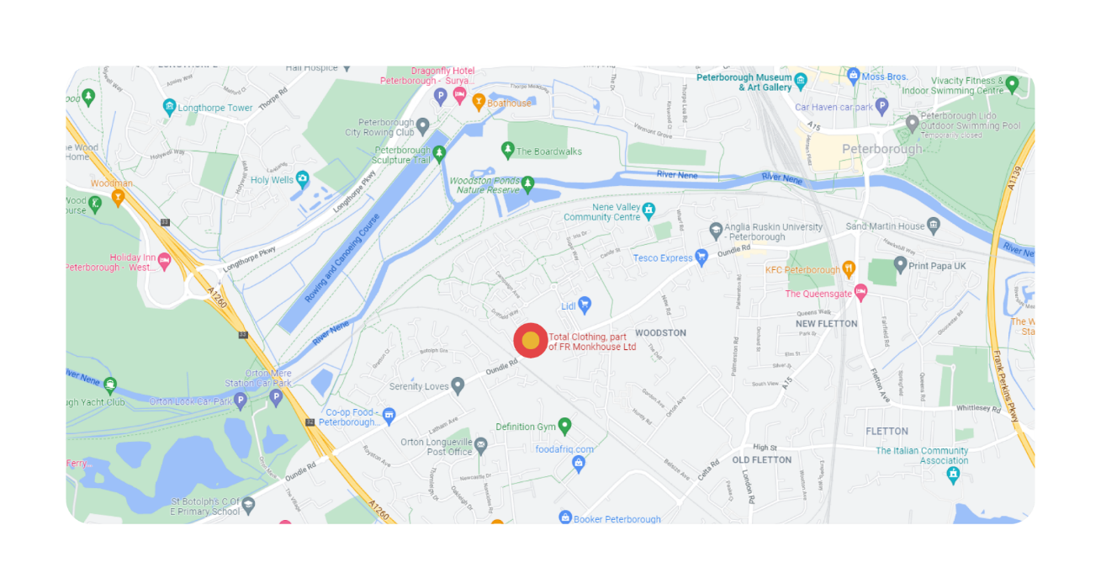

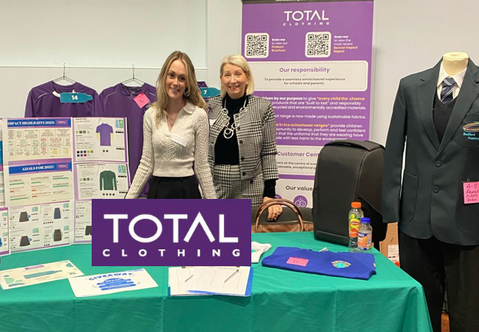
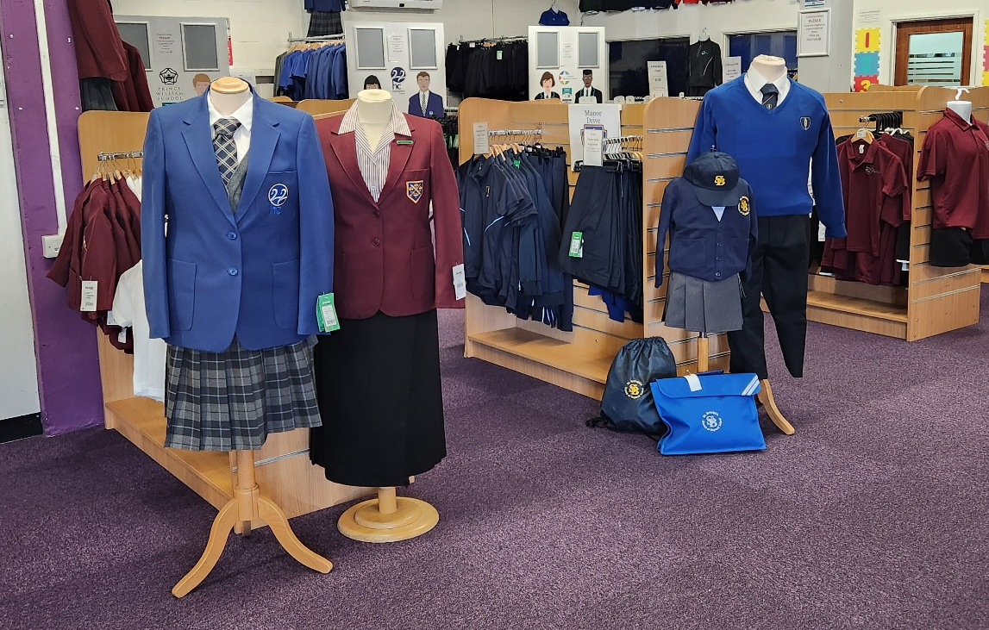
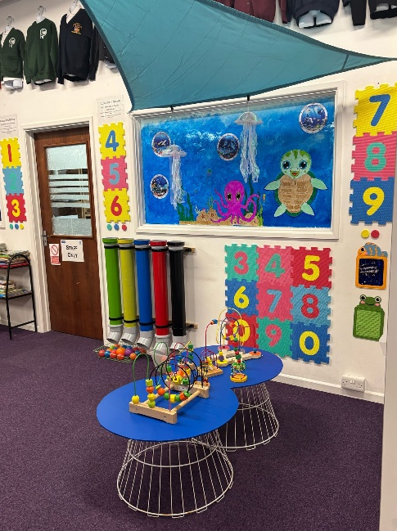
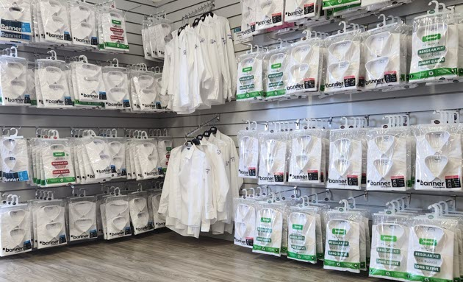

Visit us in store…
School Shop Opening Times:
Monday – Friday: 9am – 5pm
During the summer holidays we are open on a Saturday from 10am till 4pm.
Where to find us:
No.9 Botolph Trading Estate, Oundle Road, Peterborough, PE2 9QP

